Slide 1


DEPI
Sales & Customer Performance
Dashboard Analysis Project
Tableau
Retail Sales Data 2020–2023
PREPARED BY:
Arwa Yasser
SUPERVISED BY:
Dr. Ahmed Ismail
JUN/2026
Notes:
Welcome to our final project presentation. This deck covers a full Business Intelligence solution built on 9,994 retail transaction records spanning 2020–2023. The project delivers three interactive dashboards covering Sales Overview, Customer Analysis, and Product Analysis, developed in Tableau and Power BI by Team 2 as part of the DEPI graduation project.

Slide 2
Table of Contents
Table of Contents
Project Overview
Dashboard Products Analysis
01
05
Background, Problem, Objectives & Scope
Product KPIs, treemap, sales vs. target & profit
Dataset & Methodology
Key Findings & Insights
02
06
Data sources, cleaning, transformation & modeling
Critical discoveries across all three dashboards
Dashboard Sales Overview
Strategic Recommendations
03
07
KPIs, trends, categories & regional performance
Data-driven actions for business growth
Dashboard Customer Analysis
Executive Summary
04
08
Customer growth, segmentation, behavior & geography
Conclusions, impact & next steps
2
Notes:
This presentation is organized into eight major sections. We begin with the project context and problem statement, then cover our data and methodology before presenting the three dashboards in detail. We then consolidate key insights before delivering strategic recommendations and an executive summary.

Slide 3
01 | Project Overview
Background · Business Problem · Objectives · Scope
Notes:
Section one covers the project context, the business problem that motivated this analysis, our specific objectives, and the scope of the solution we delivered.

Slide 4
Project Overview — Background & Business Problem
🏢 Background
⚠️ Business Problem
An American retail company sells products across three major categories — Furniture, Office Supplies, and Technology — operating in four US regions: Central, East, South, and West.
With four years of transactional data (2020–2023) and nearly 10,000 order records, management lacked a unified analytics platform to monitor KPIs and make data-driven decisions.
The company needed a solution that transforms raw data into actionable intelligence.
1. No unified view of sales, profit, and order KPIs across years
2. Inability to compare current vs. prior year performance dynamically
3. No visibility into which products, regions, or segments drive profit
4. Customer behavior and retention trends were not being tracked
5. Monthly and seasonal patterns were invisible to decision-makers
6. Product performance gaps vs. sales targets were unmonitored
4
Notes:
The company had raw data but no structured way to surface insights. Decision-makers were flying blind — unable to compare performance year over year, identify underperforming segments, or plan seasonally. This project addresses that gap by building a fully interactive BI solution.

Slide 5
Project Objectives & Scope
Three dashboards, one unified analytical story
📊 Sales Performance
👥 Customer Analytics
📦 Product Intelligence
Track Total Sales ($733K), Profit ($93K), Orders (1,687) and Growth Rate (+20.4%) with YoY comparison for any selected year.
Monitor 693 active customers, 493 returning customers (within-year), and 2.4 avg orders/customer with monthly and segment-level drill-down.
Identify top-selling products (Phones $105K), highest-revenue categories (Technology $272K), and profitability by sub-category.
🗺️ Geographic Insights
🔗 Interactivity
🎯 Strategic Support
Visualize revenue and profit by US state and region; flag negative-profit states like Illinois (-$6.75K) for corrective action.
Enable stakeholders to filter by Year, Region, Category, and Segment across all three dashboards with cross-dashboard navigation.
Surface actionable gaps — seasonal dips (Feb $20K), mixed monthly target performance in 2023 (5 months exceeded, 4 months missed) — to guide marketing and inventory decisions.
5
Notes:
The project has six core objectives organized around sales performance, customer analytics, product intelligence, geographic insights, interactivity, and strategic decision support. Each objective maps directly to one or more charts within the three interactive dashboards.

Slide 6
02 | Dataset & Methodology
Data Sources · Cleaning · Transformation · Star Schema
Notes:
Section two covers how we gathered, cleaned, and structured the data before building visualizations.

Slide 7
Dataset Description — Four Interconnected CSV Files
Orders
9,994 rows · 15 columns
Customers
793 rows · 2 columns
Fact Table
Dimension
🔑 Key: Order ID, Customer ID, Product ID, Postal Code 📋 Fields: Sales, Profit, Quantity, Discount, Ship Date, Segment
🔑 Key: Customer ID 📋 Fields: Customer ID, Customer Name — unique customer registry
Location
632 rows · 5 columns
Products
1,894 rows · 4 columns
Dimension
Dimension
🔑 Key: Postal Code 📋 Fields: City, State, Region, Country/Region — geographic dimension
🔑 Key: Product ID 📋 Fields: Category, Sub-Category, Product Name — product hierarchy
Notes:
The dataset follows a Star Schema design. The Orders fact table is the central hub containing all transactional records. It links outward to three dimension tables: Customers (who bought), Location (where they bought from), and Products (what they bought). This design enables efficient filtering and aggregation across any dimension.

Slide 8
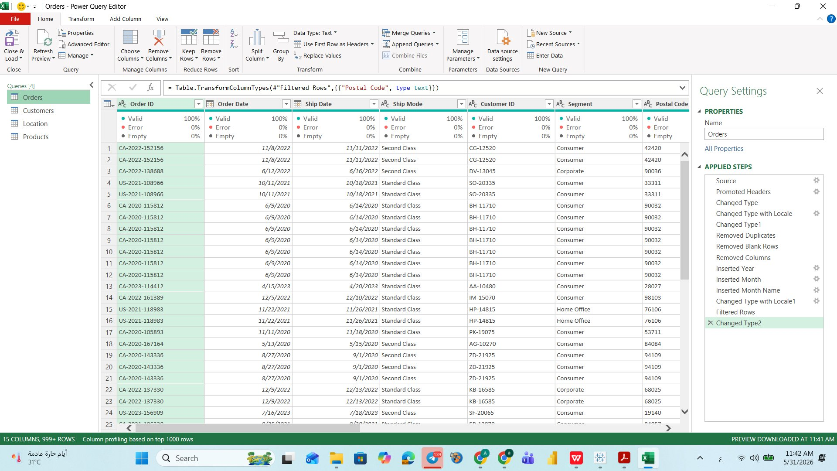
Data Cleaning & Transformation — Power Query Editor
Applied Cleaning Steps (Orders)
Source
Promote Headers
Change Types
Remove Duplicates
Remove Blank Rows
Trimmed & Cleaned Text
Capitalize Each Word
Filtered Rows
Inserted Year/Month
Notes:
We used Power Query Editor in both Power BI and Excel to apply 9 systematic cleaning steps to each of the four tables. The Orders table required the most work — including date type correction, locale adjustments for both Order Date and Ship Date, and the insertion of calculated Year and Month Name columns to enable time-intelligence comparisons.

Slide 9
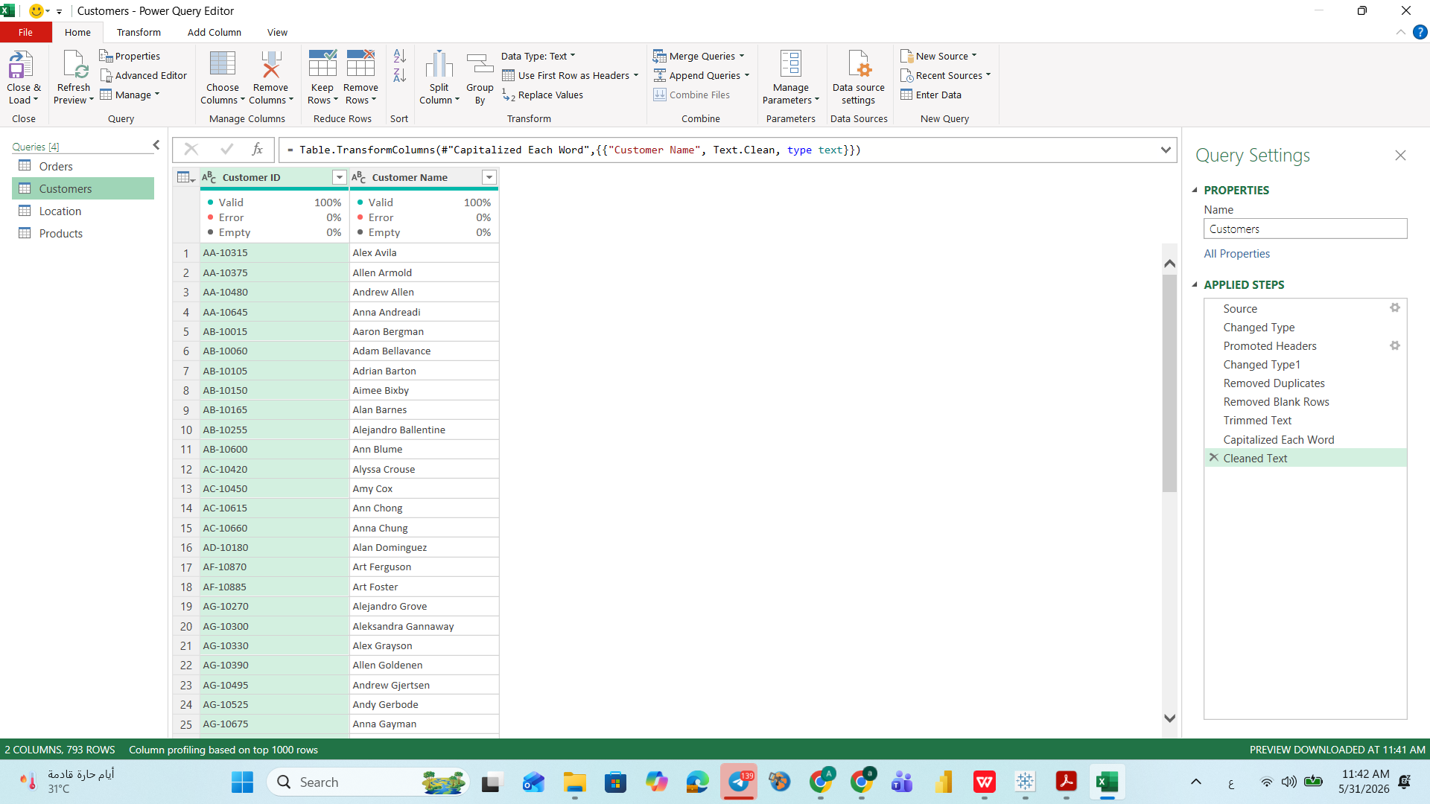
Data Cleaning & Transformation — Power Query Editor
Applied Cleaning Steps (Customers)
Source
Promote Headers
Change Types
Remove Duplicates
Remove Blank Rows
Trimmed & Cleaned Text
Capitalize Each Word
Cleaned Text
Notes:
We used Power Query Editor in both Power BI and Excel to apply 9 systematic cleaning steps to each of the four tables. The Orders table required the most work — including date type correction, locale adjustments for both Order Date and Ship Date, and the insertion of calculated Year and Month Name columns to enable time-intelligence comparisons.

Slide 10
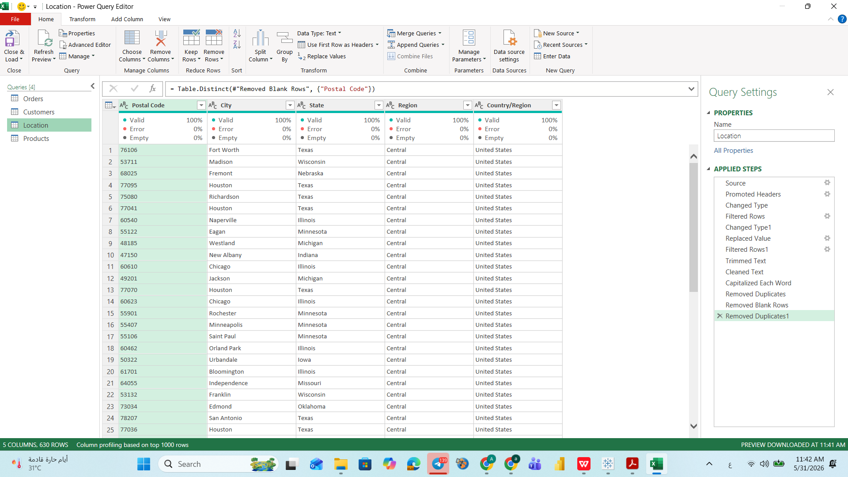
Data Cleaning & Transformation — Power Query Editor
Applied Cleaning Steps (Location)
Source
Promote Headers
Change Types
Remove Duplicates
Remove Blank Rows
Trimmed & Cleaned Text
Capitalize Each Word
Filtered Rows
Cleaned Text
Notes:
We used Power Query Editor in both Power BI and Excel to apply 9 systematic cleaning steps to each of the four tables. The Orders table required the most work — including date type correction, locale adjustments for both Order Date and Ship Date, and the insertion of calculated Year and Month Name columns to enable time-intelligence comparisons.

Slide 11
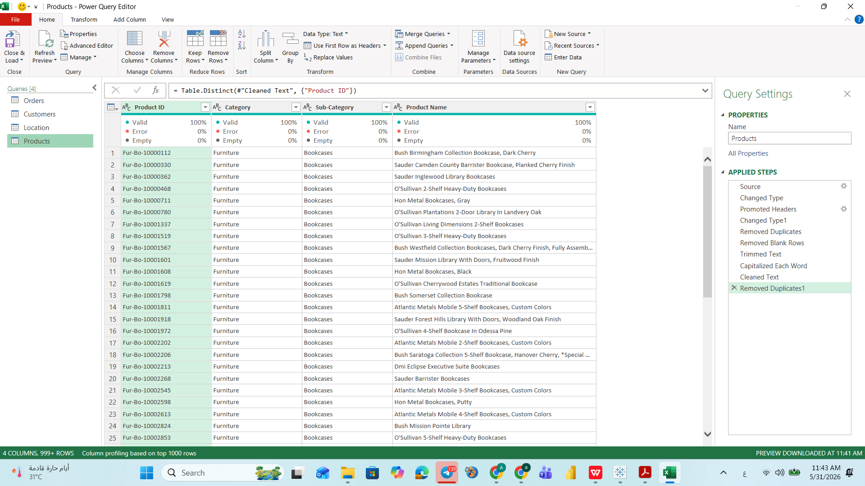
Data Cleaning & Transformation — Power Query Editor
Applied Cleaning Steps (Products)
Source
Promote Headers
Change Types
Remove Duplicates
Remove Blank Rows
Trimmed & Cleaned Text
Capitalize Each Word
Cleaned Text
Notes:
We used Power Query Editor in both Power BI and Excel to apply 9 systematic cleaning steps to each of the four tables. The Orders table required the most work — including date type correction, locale adjustments for both Order Date and Ship Date, and the insertion of calculated Year and Month Name columns to enable time-intelligence comparisons.

Slide 12
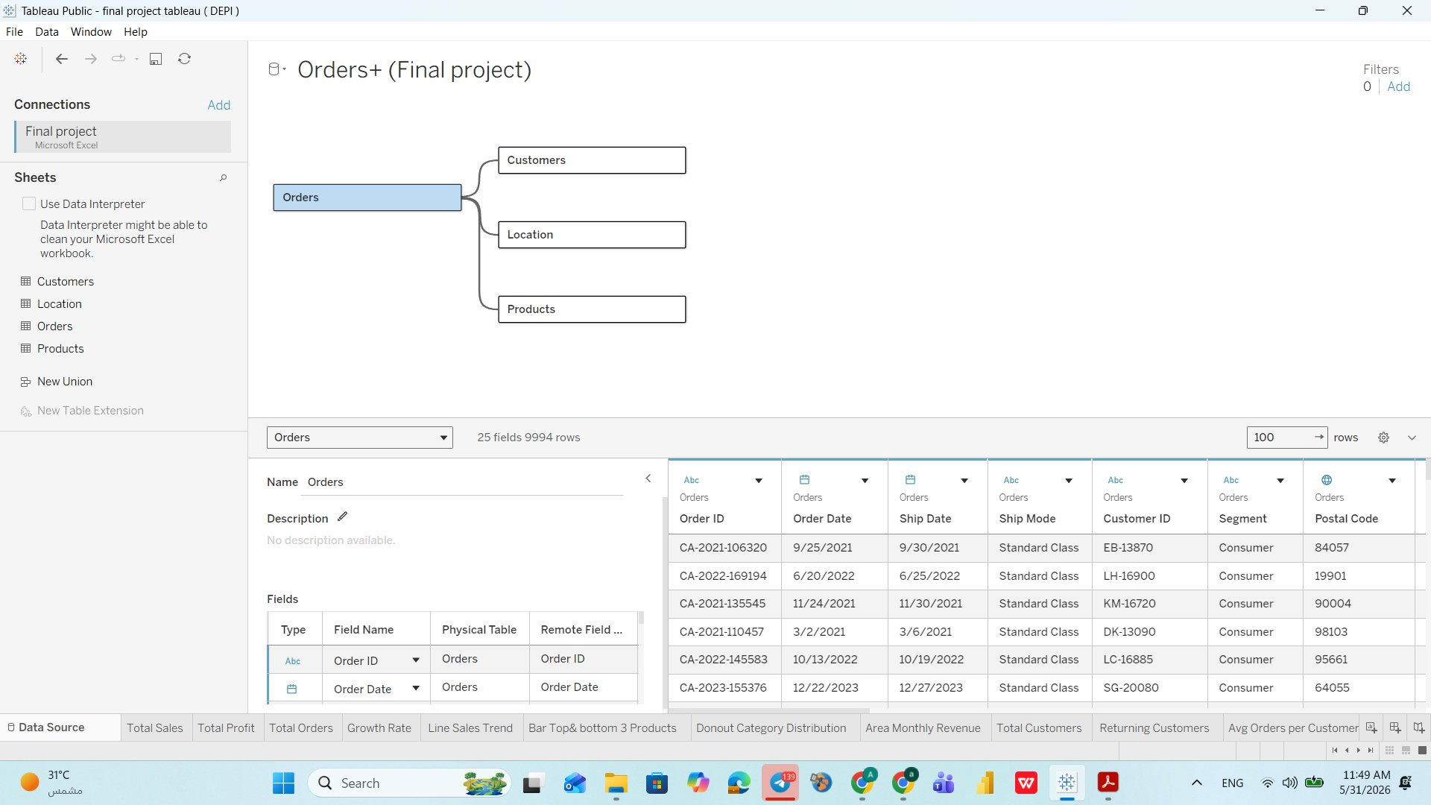
Data Model — Star Schema Architecture
Model Architecture
Fact Table
Orders (9,994 rows) — central hub of all transactions
→ Customers
Joined on Customer ID — who placed each order
→ Location
Joined on Postal Code — where orders originated
→ Products
Joined on Product ID — what was ordered
Relationships
All Many-to-One from Orders to dimensions
Calculated Fields
24+ custom measures for KPIs and YoY logic
Parameters
Select Year parameter drives all time comparisons
Notes:
The Star Schema places the Orders fact table at the center with three dimension tables radiating outward. Every filter applied in the dashboard — whether by Category, Region, or Segment — passes through these relationships. The model supports 24-plus calculated fields that power all KPI cards and year-over-year comparisons.

Slide 13
Calculated Fields & Business Logic — Custom Measures
Every KPI card and percentage change is powered by a custom-built calculated field or measure
Sales Measures
Profit Measures
▪ Current Year Sales (SUM)
▪ Prior Year Sales (SUM)
▪ Sales Growth %
▪ Sales Target
▪ Current Year Profit
▪ Prior Year Profit
▪ Profit Growth %
▪ Average Profit
▪ Negative Profit flag
Order Measures
Customer Measures
▪ Current Year Orders (CNTD)
▪ Orders Growth %
▪ Avg Orders per Customer
▪ Avg Orders Growth %
▪ Current Year Customers
▪ Customers Growth %
▪ Returning Customers Count
▪ Returning Customers Growth %
Notes:
The analytical power of this project comes from 24-plus custom calculated fields. They fall into four categories: sales measures, profit measures, order measures, and customer measures. The year-over-year comparisons use a Select Year parameter to dynamically define 'current year' and 'prior year' for every single metric.

Slide 14
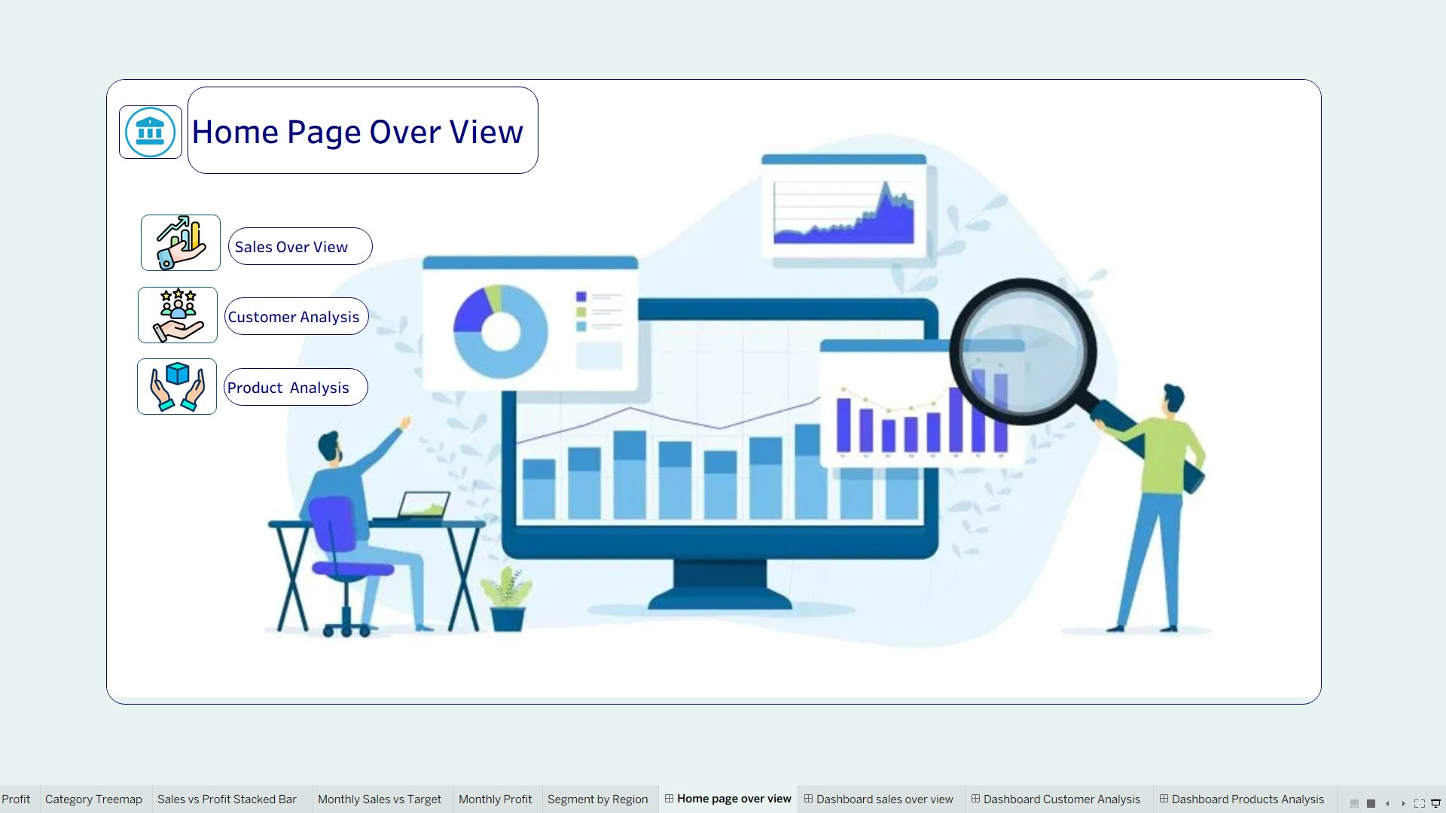
Home Page & Navigation System — Dashboard UX Design
UX Design Principles
🏠 Home Page
Central landing page with icon navigation to all 3 dashboards — Sales Overview, Customer Analysis, Product Analysis
🔗 Navigation Buttons
Icon buttons on every dashboard page allow seamless cross-dashboard navigation without back-buttons
🎨 Color Consistency
Unified navy (#1B3A6B) and teal/cyan palette maintained across all pages for professional coherence
📐 Fixed Layout
1200×800px fixed canvas ensures consistent rendering on all screens and in exports
⚡ Filter Sync
All four filters (Year, Region, Category, Sub-Category, Segment) sync across all charts on each dashboard page
Notes:
The Home Page is the entry point to the entire analytics solution. Three clearly labeled navigation buttons — Sales Overview, Customer Analysis, and Product Analysis — allow any stakeholder to jump directly to the most relevant dashboard. The UX design follows best practices: consistent colors, icon reinforcement, fixed layout, and synchronized filters that eliminate the need for manual coordination between dashboards.

Slide 15
03 | Dashboard Sales Overview
KPIs · Trends · Categories · Regional Performance
Notes:
Section three presents the first dashboard — Sales Overview — in detail. We will walk through each KPI card, chart, and filter, providing business interpretation for every element.

Slide 16
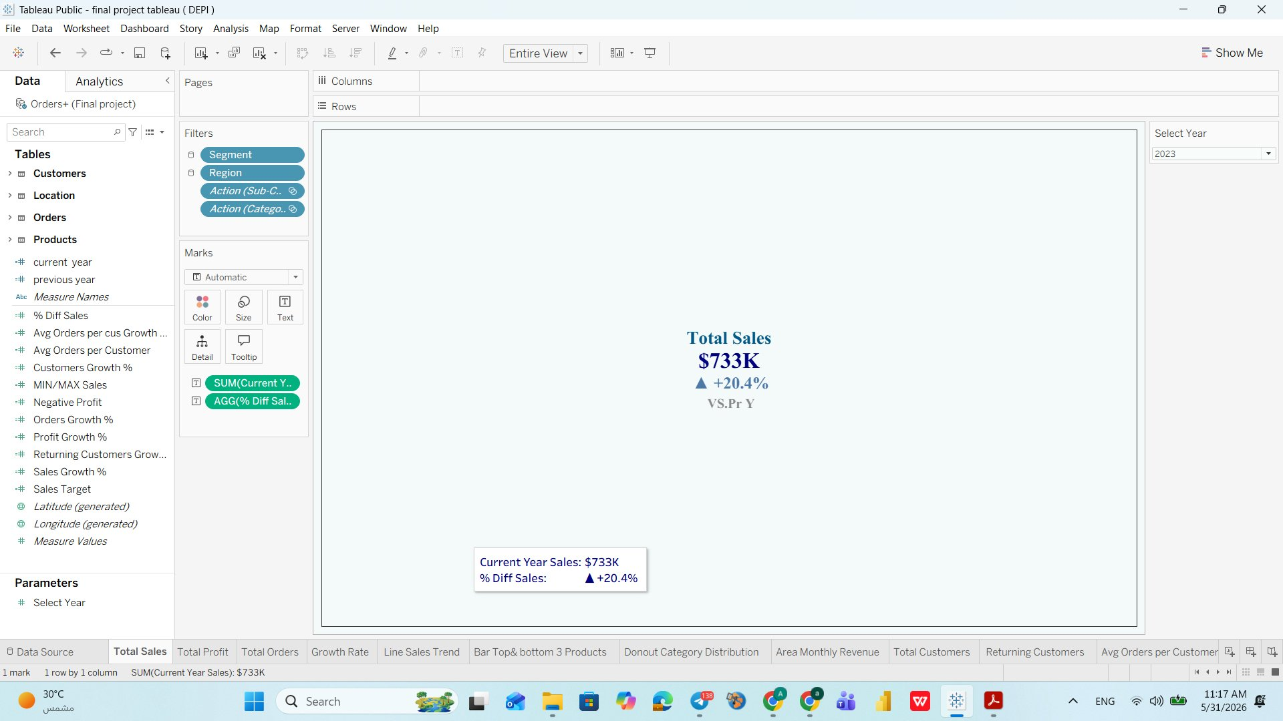
Sales Dashboard — KPI Cards Analysis ( Total Sales)
Total Sales KPI Card – How It Works
What it shows:
Current Year Total Sales = $733K
Growth vs Previous Year = +20.4%
Business Question
What is the total revenue generated this year, and are we growing vs. last year?
Answer
$733K in sales in 2023 — +20.4% increase over 2022, the highest in the dataset.
Insight
Sales grew faster (+20.4%) than profit (+14.2%), signaling discounting or rising costs are eroding margins.
Recommendation
Audit discount policies and set a minimum profit margin per order to ensure revenue growth converts to real profit.
Notes:
The four KPI cards are the first thing every decision-maker reads. Total Sales of $733K with 20.4% growth signals strong market momentum. However, the gap between order growth (28.3%) and profit growth (14.2%) is a red flag — it means more orders are being placed but at lower margins. This could be caused by discounting, freight costs, or a product mix shift toward lower-margin items.

Slide 17
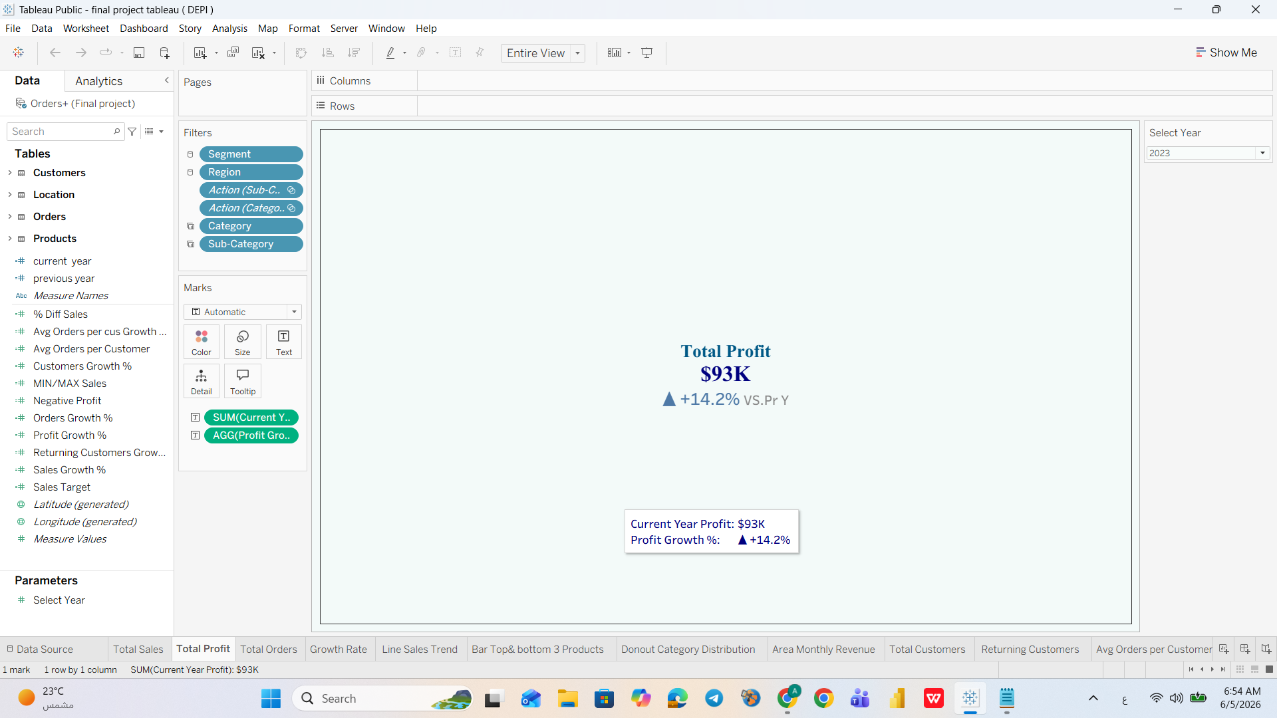
Sales Dashboard — KPI Cards Analysis ( Total Profit)
Business Question
How profitable is the business this year, and is profitability improving?
Answer
$93K profit in 2023, up +14.2% from 2022.
Insight
Profit lags behind sales (+20.4%) and orders (+28.3%) growth — each order is becoming less profitable. A widening danger sign.
Recommendation
Identify products and accounts dragging margins. Eliminate loss-makers like Tables sub-category and reprice Grant Thornton.
Notes:
The four KPI cards are the first thing every decision-maker reads. Total Sales of $733K with 20.4% growth signals strong market momentum. However, the gap between order growth (28.3%) and profit growth (14.2%) is a red flag — it means more orders are being placed but at lower margins. This could be caused by discounting, freight costs, or a product mix shift toward lower-margin items.

Slide 18
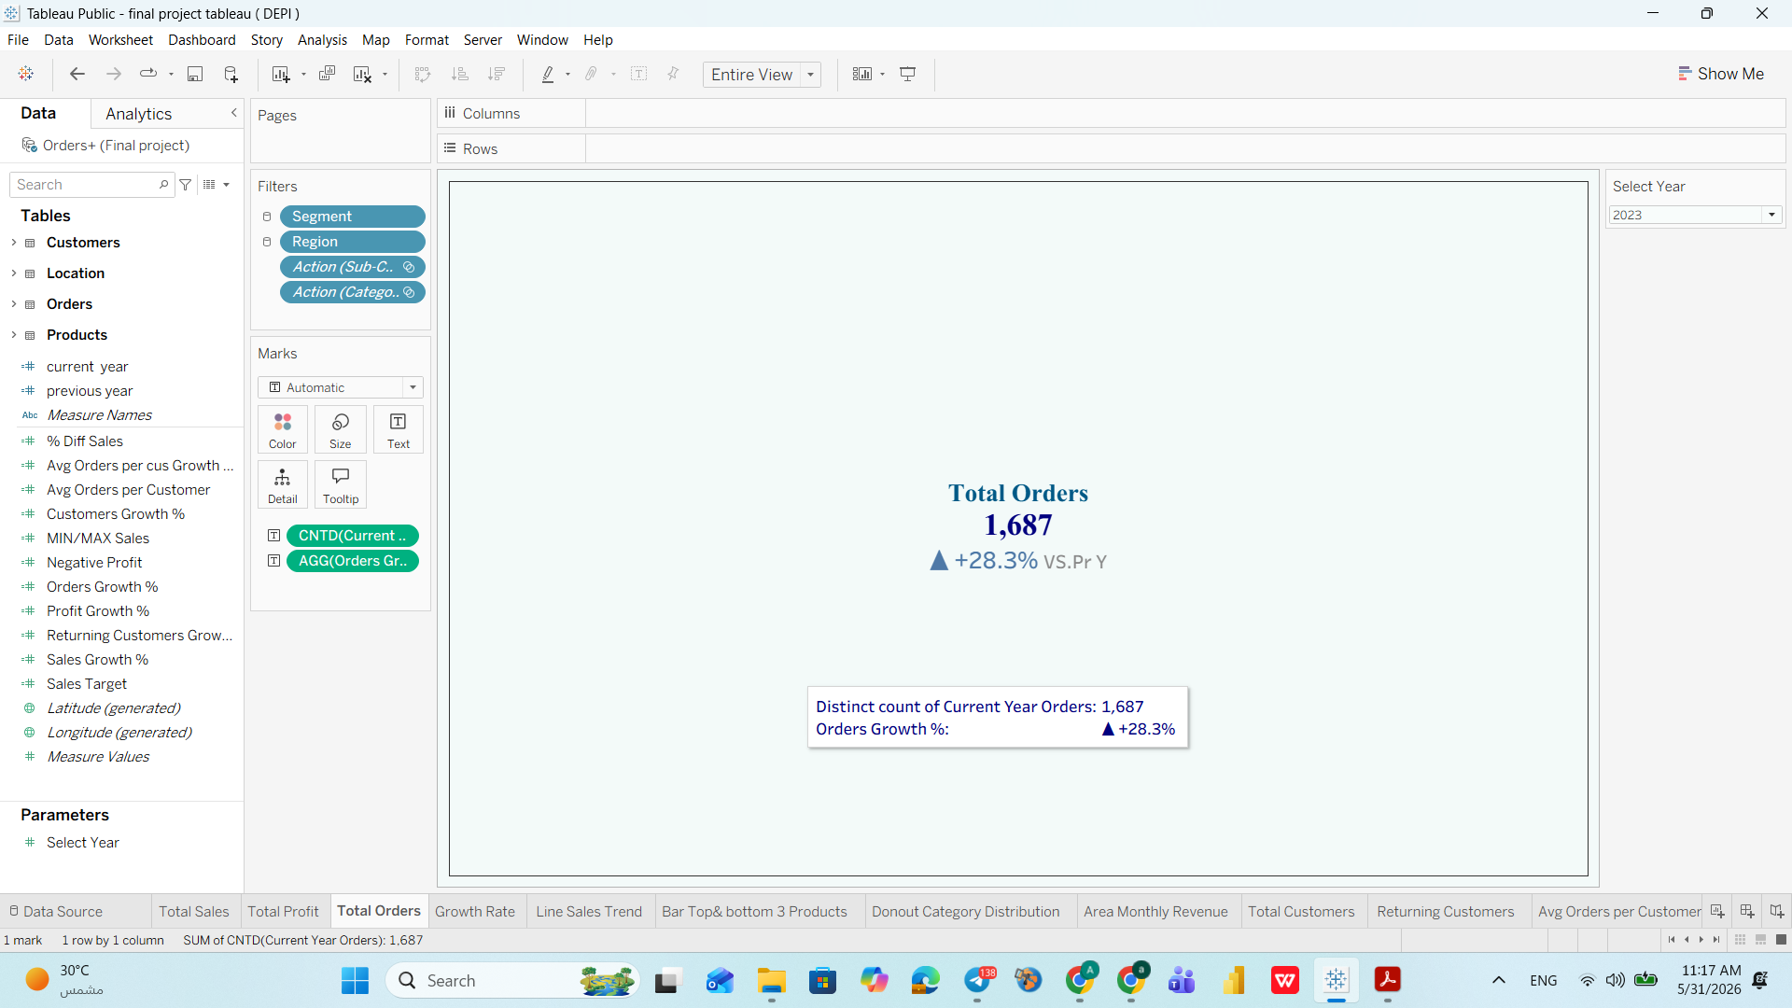
Sales Dashboard — KPI Cards Analysis ( Total Orders)
Business Question
How many orders were placed this year, and is order volume growing?
Answer
1,687 orders in 2023 — +28.3% surge, the fastest-growing KPI on the dashboard.
Insight
Orders grow nearly 2x faster than profit. More transactions but less earned per transaction — a classic sign of over-discounting.
Recommendation
Shift focus from order volume to order value. Introduce minimum order thresholds and upsell strategies on high-margin products like Copiers.
Notes:
The four KPI cards are the first thing every decision-maker reads. Total Sales of $733K with 20.4% growth signals strong market momentum. However, the gap between order growth (28.3%) and profit growth (14.2%) is a red flag — it means more orders are being placed but at lower margins. This could be caused by discounting, freight costs, or a product mix shift toward lower-margin items.

Slide 19
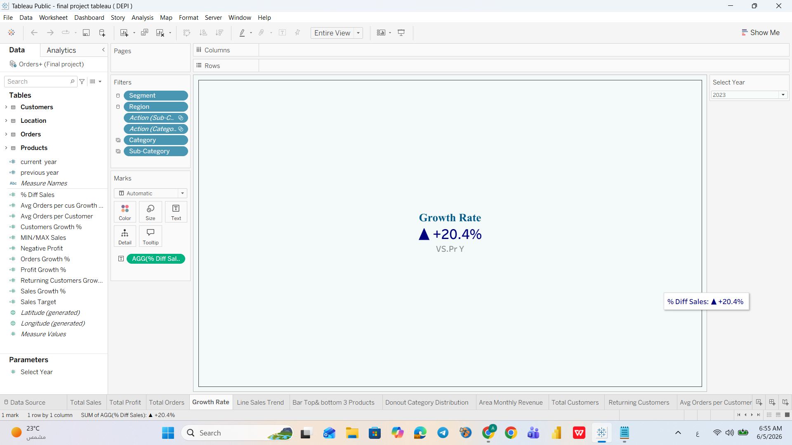
Sales Dashboard — KPI Cards Analysis ( Growth Rate)
Business Question
What is the year-over-year growth rate, and is the business scaling efficiently?
Answer
The business grew at +20.4% in 2023 vs. 2022 — a strong headline number.
Insight
When set against order growth (+28.3%) and profit growth (+14.2%), growth is uneven — scaling in volume but losing efficiency per order.
Recommendation
Set a KPI for 'profitable growth rate': for every 1% sales increase, profit should grow by at least 0.8-1%. Monitor monthly.
Notes:
The four KPI cards are the first thing every decision-maker reads. Total Sales of $733K with 20.4% growth signals strong market momentum. However, the gap between order growth (28.3%) and profit growth (14.2%) is a red flag — it means more orders are being placed but at lower margins. This could be caused by discounting, freight costs, or a product mix shift toward lower-margin items.

Slide 20
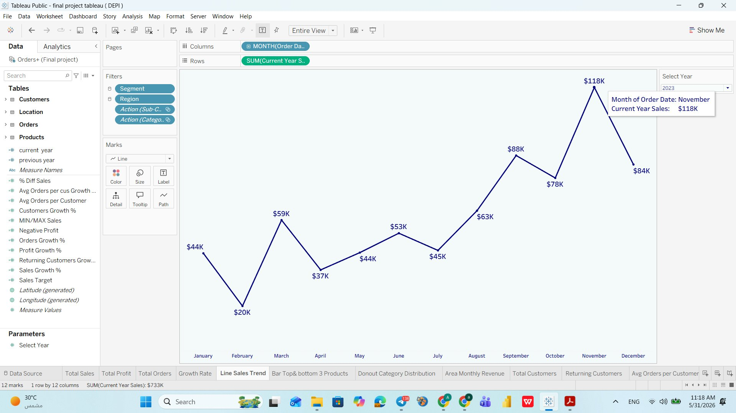
Line Sales Trend — Monthly Revenue Pattern (2023)
Business Question
How do monthly sales fluctuate throughout the year, and when are peaks and troughs?
Answer
Sales peak in November ($118K) and bottom out in February ($20K) — a 490% swing across the year.
Insight
The business is extremely seasonal. February is structurally weak every year. May shows the largest gap vs. prior year — an exceptional event. August dips recur in both 2022 and 2023.
Recommendation
Launch 'New Year, New Office' bundles in February. Pre-plan inventory for August dip. Investigate what drove the May spike and replicate it.
Notes:
The line chart reveals a classic retail seasonality pattern. February is the weakest month at only $20K — less than 18% of the peak November figure. The March recovery to $59K suggests demand is latent, not permanently lost. Q4 shows the strongest performance, consistent with holiday purchasing. Management should invest in February promotions and capitalize on the November peak with adequate inventory planning.

Slide 21
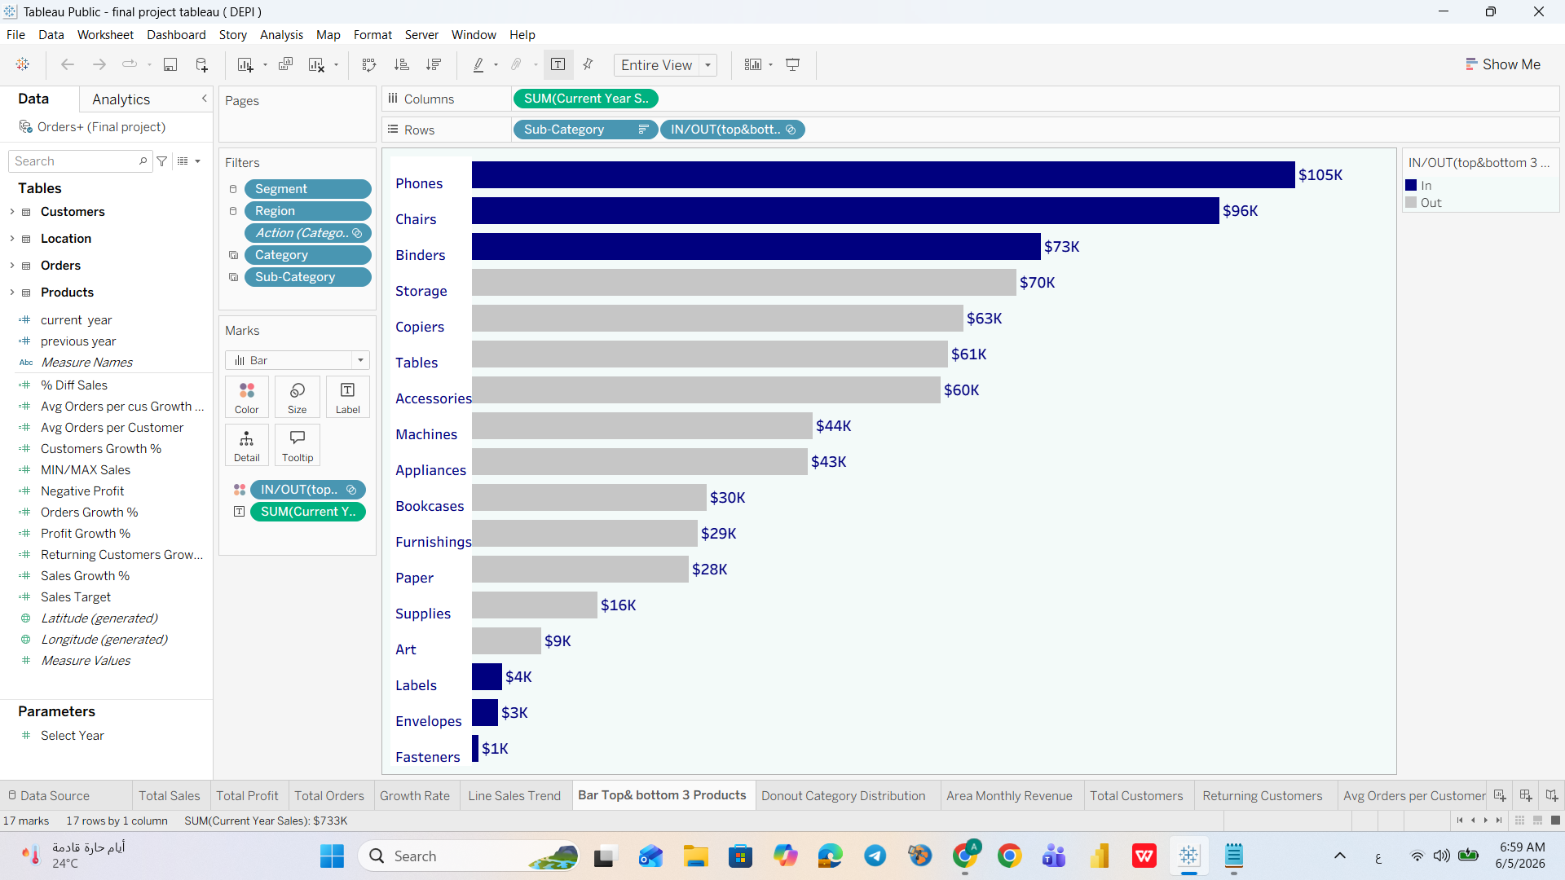
Bar Top/Bottom 3 Products
Business Question
Which sub-categories are driving the most and least revenue?
Answer
Top 3: Phones ($105K), Chairs ($96K), Binders ($73K). Bottom 3: Fasteners, Labels, Envelopes — all under $15K combined.
Insight
Top 3 alone drive a disproportionate revenue share. Bottom 3 consume warehouse space and management attention with minimal return.
Recommendation
Double down on Phones, Chairs, Binders with dedicated stock and promotions. Evaluate bottom 3 for full-cost profitability — if negative, discontinue or bundle.
Notes:
The line chart reveals a classic retail seasonality pattern. February is the weakest month at only $20K — less than 18% of the peak November figure. The March recovery to $59K suggests demand is latent, not permanently lost. Q4 shows the strongest performance, consistent with holiday purchasing. Management should invest in February promotions and capitalize on the November peak with adequate inventory planning.

Slide 22
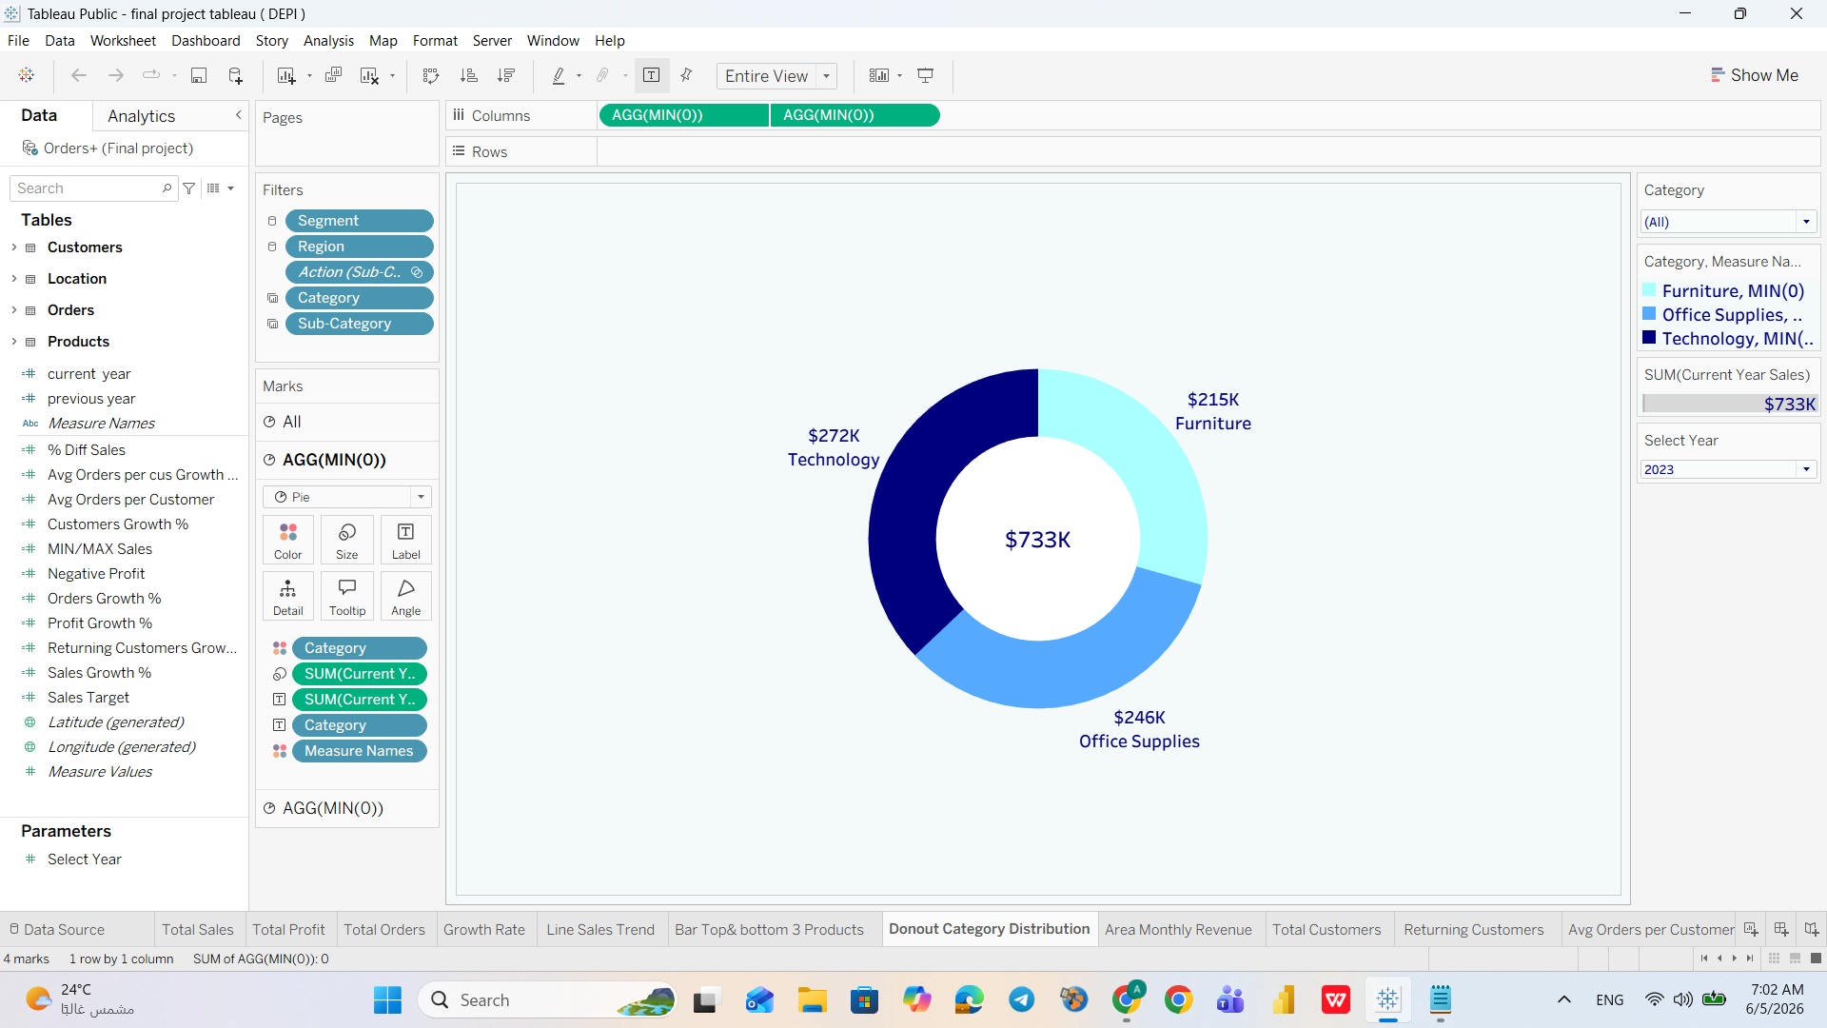
Donut Category Distribution
Business Question
How is revenue distributed across the three product categories?
Answer
Technology: $272K (37%) | Office Supplies: $246K (34%) | Furniture: $215K (29%). Relatively balanced.
Insight
The balance masks danger: Furniture's 29% hides the profit-negative Tables sub-category. Revenue share overstates Furniture's true value.
Recommendation
Do not manage by category revenue alone. Drill into sub-category profitability — fix the Tables problem within Furniture to protect overall margins.
Notes:
The line chart reveals a classic retail seasonality pattern. February is the weakest month at only $20K — less than 18% of the peak November figure. The March recovery to $59K suggests demand is latent, not permanently lost. Q4 shows the strongest performance, consistent with holiday purchasing. Management should invest in February promotions and capitalize on the November peak with adequate inventory planning.

Slide 23
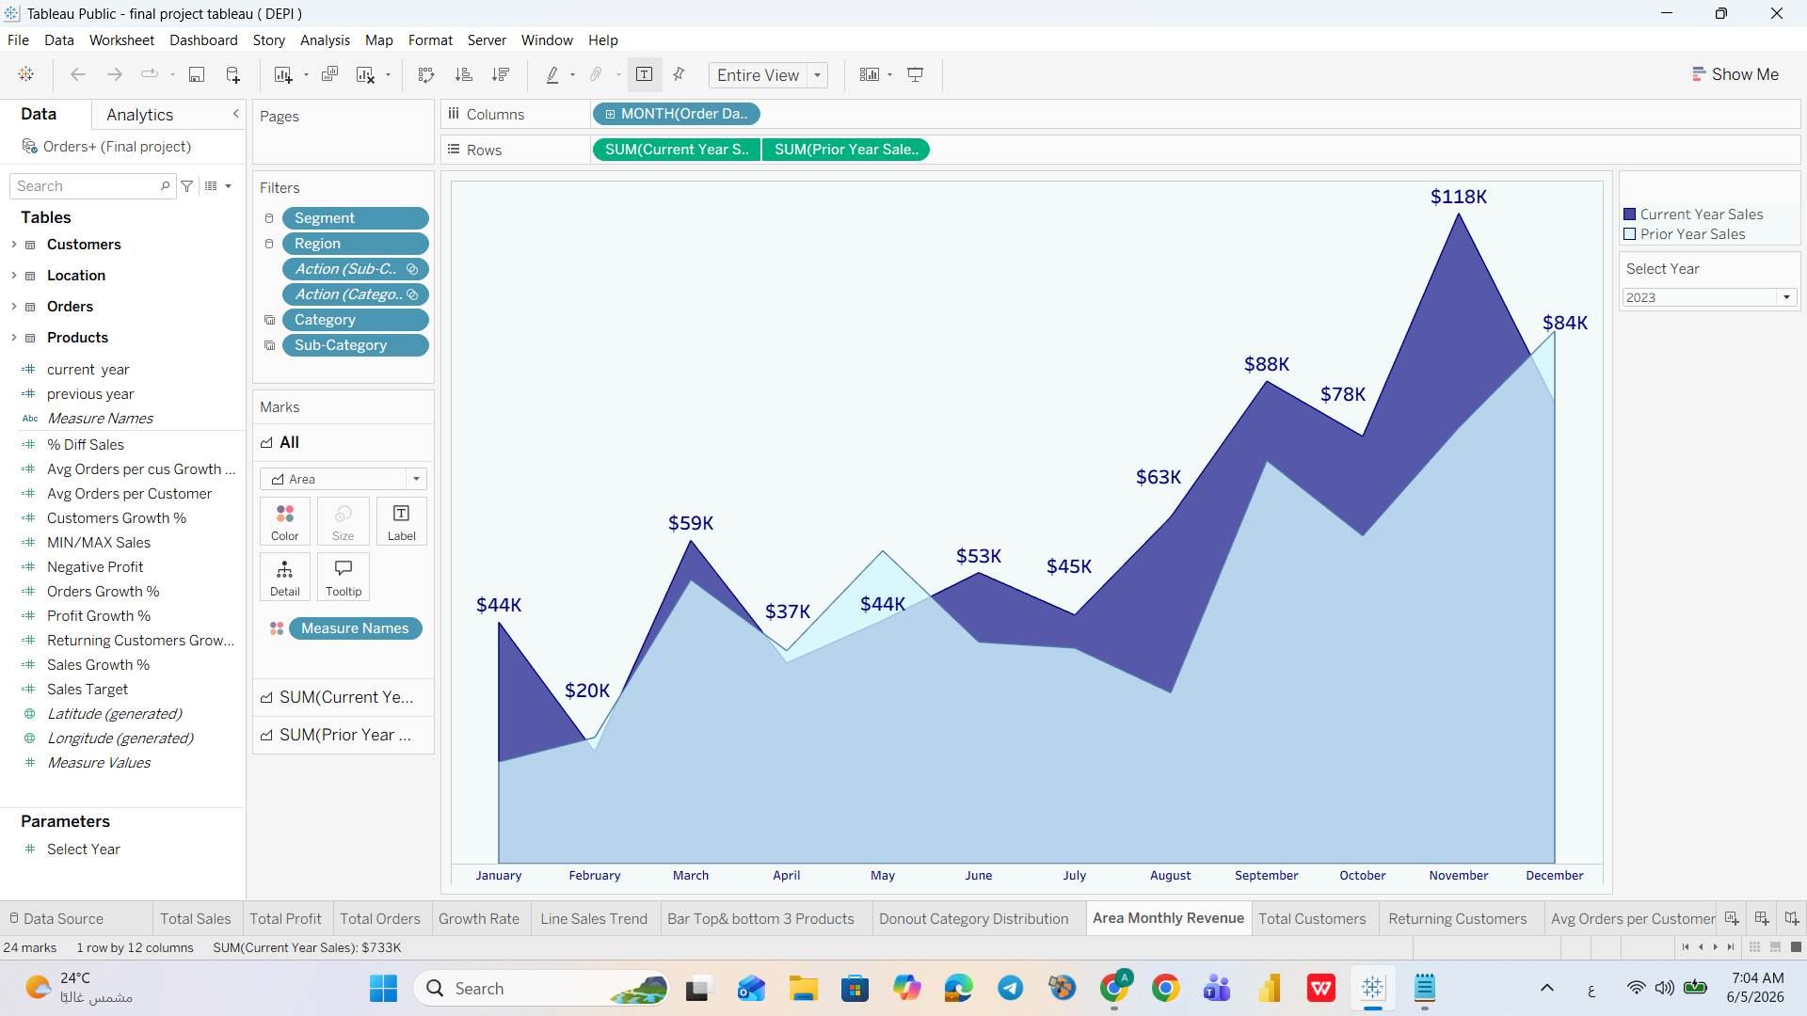
Area Monthly Revenue — Current Year vs. Prior Year Comparison
Business Question
Is this year performing better than last year month by month, and where are the biggest improvements?
Answer
2023 consistently outperforms 2022. The biggest overlap (improvement) is in Q4 (Oct-Dec). Mid-year shows the smallest gap.
Insight
Growth is concentrated in Q4 and unevenly distributed across the year. Mid-year months underperform relative to their potential.
Recommendation
Develop strategies to replicate Q4 patterns earlier in the year. Identify what drives Q4 outperformance and apply those levers in Q2.
Notes:
The line chart reveals a classic retail seasonality pattern. February is the weakest month at only $20K — less than 18% of the peak November figure. The March recovery to $59K suggests demand is latent, not permanently lost. Q4 shows the strongest performance, consistent with holiday purchasing. Management should invest in February promotions and capitalize on the November peak with adequate inventory planning.

Slide 24
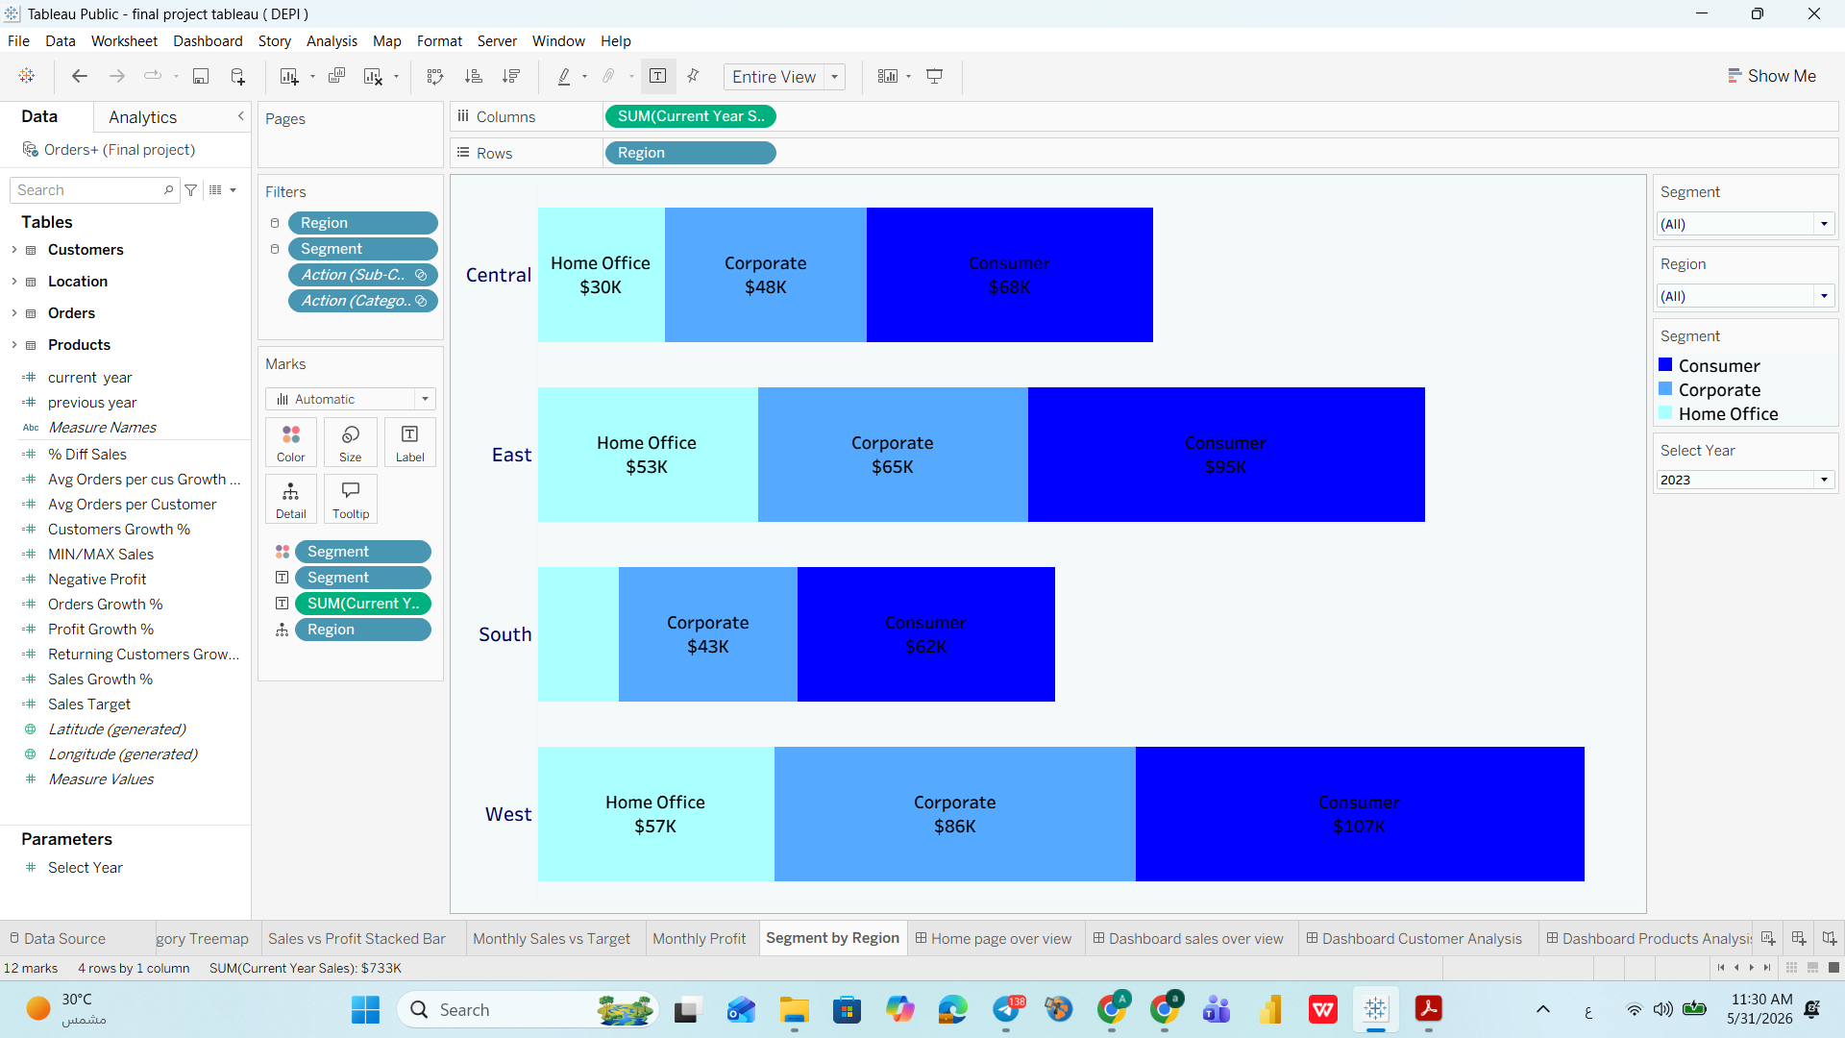
Segment by Region — Sales Distribution Across 4 US Regions
Business Question
Which regions and customer segments generate the most revenue, and where are the biggest opportunities?
Answer
West leads overall. Consumer dominates every region. West Consumer tops at $107K. South is weakest (~$105K total). Central Home Office at ~$30K is nearly untapped.
Insight
West's success proves what's possible. South underperforms despite being a large US market. Central Home Office represents a clear expansion opportunity.
Recommendation
Invest marketing in South and Central. Study West's success drivers and replicate them. Create dedicated Home Office bundles for Central remote workers.
Notes:
The line chart reveals a classic retail seasonality pattern. February is the weakest month at only $20K — less than 18% of the peak November figure. The March recovery to $59K suggests demand is latent, not permanently lost. Q4 shows the strongest performance, consistent with holiday purchasing. Management should invest in February promotions and capitalize on the November peak with adequate inventory planning.

Slide 25
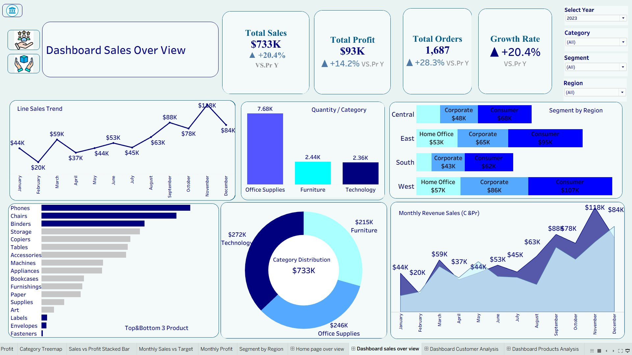
Dashboard Sales Overview — Complete View (2023)
Notes:
This is the complete Sales Overview dashboard for the year 2023. It contains four KPI cards at the top — Total Sales, Total Profit, Total Orders, and Growth Rate — followed by six analytical charts: a line trend, a quantity bar chart, top/bottom 3 products, a segment-by-region stacked bar, a category distribution donut, and a monthly revenue area chart comparing current vs. prior year. All visuals respond to the global filters on the right side.

Slide 26
04 | Dashboard Customer Analysis
Customer Growth · Segmentation · Behavior · Geography
Notes:
Section four covers the Customer Analysis dashboard — the second of our three interactive dashboards. We will analyze customer KPIs, their geographic distribution, purchase behavior, and segment composition.

Slide 27
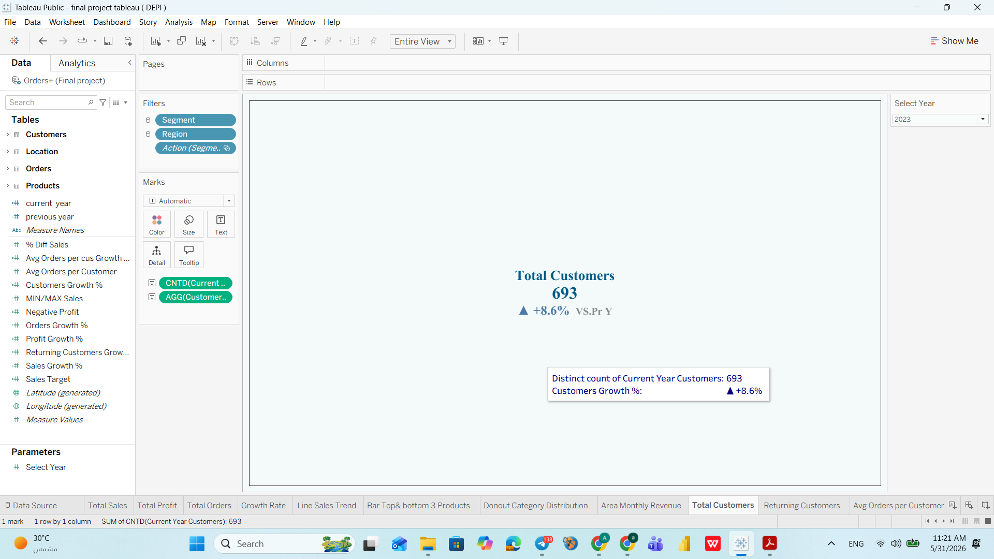
Customer KPIs — Total Customers KPI Card
Business Question
How many unique customers purchased this year, and is the customer base growing?
Answer
693 unique customers in 2023 — growing at only +8.6%, the slowest-growing KPI on the dashboard.
Insight
Customer acquisition lags far behind order growth (+28.3%) and sales growth (+20.4%). The company relies on existing customers, not new ones — a long-term risk.
Recommendation
Launch a referral program and set a quarterly new customer acquisition target of at least +15% growth. Invest in top-of-funnel marketing.
Notes:
The line chart reveals a classic retail seasonality pattern. February is the weakest month at only $20K — less than 18% of the peak November figure. The March recovery to $59K suggests demand is latent, not permanently lost. Q4 shows the strongest performance, consistent with holiday purchasing. Management should invest in February promotions and capitalize on the November peak with adequate inventory planning.

Slide 28
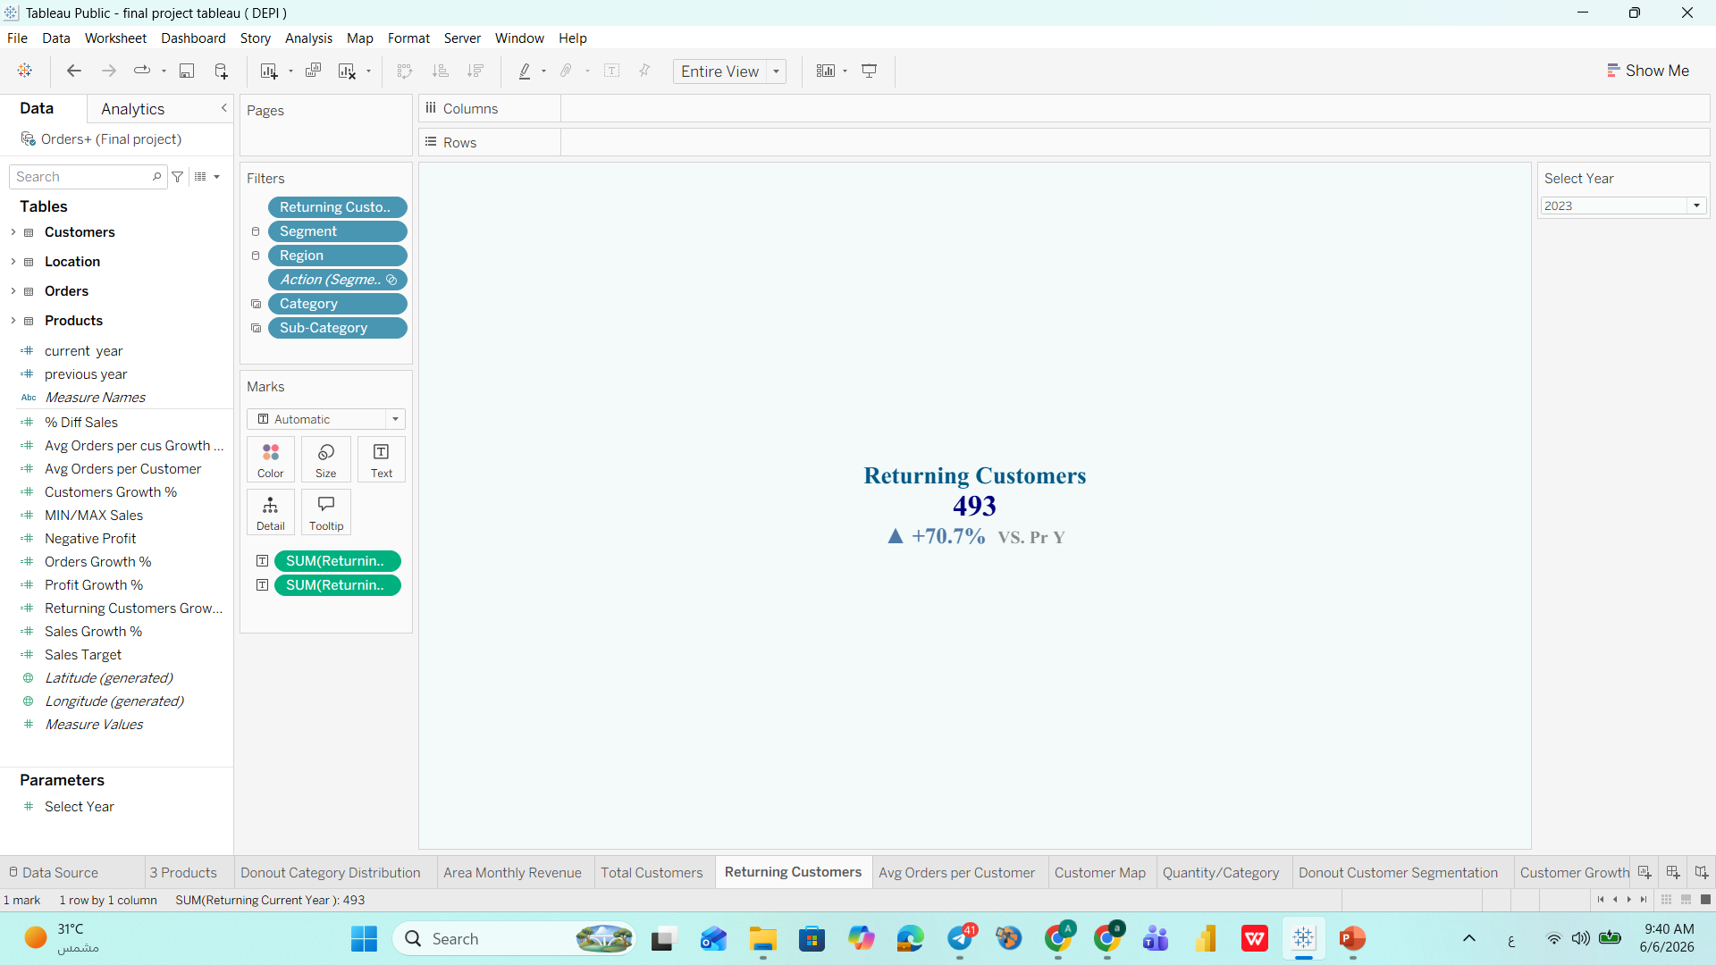
Customer KPIs — Returning Customers KPI Card
Business Question
How many customers are coming back to buy again, and is loyalty improving?
Answer
493 returning customers in 2023, growing at an impressive +70.7% — the second fastest-growing KPI.
Insight
Returning customers (493) who purchased more than once within 2023 demonstrate strong in-year loyalty. New customers total 693 — meaning new acquisition still exceeds in-year returning customers, highlighting the importance of re-engagement strategies..
Recommendation
Build a formal loyalty program to convert first-time buyers into returning customers within the same year. Create VIP tiers for high-frequency buyers (e.g. Seth Vernon: 73 orders). Consider annual subscription models to lock in repeat purchases.
Notes:
The line chart reveals a classic retail seasonality pattern. February is the weakest month at only $20K — less than 18% of the peak November figure. The March recovery to $59K suggests demand is latent, not permanently lost. Q4 shows the strongest performance, consistent with holiday purchasing. Management should invest in February promotions and capitalize on the November peak with adequate inventory planning.

Slide 29
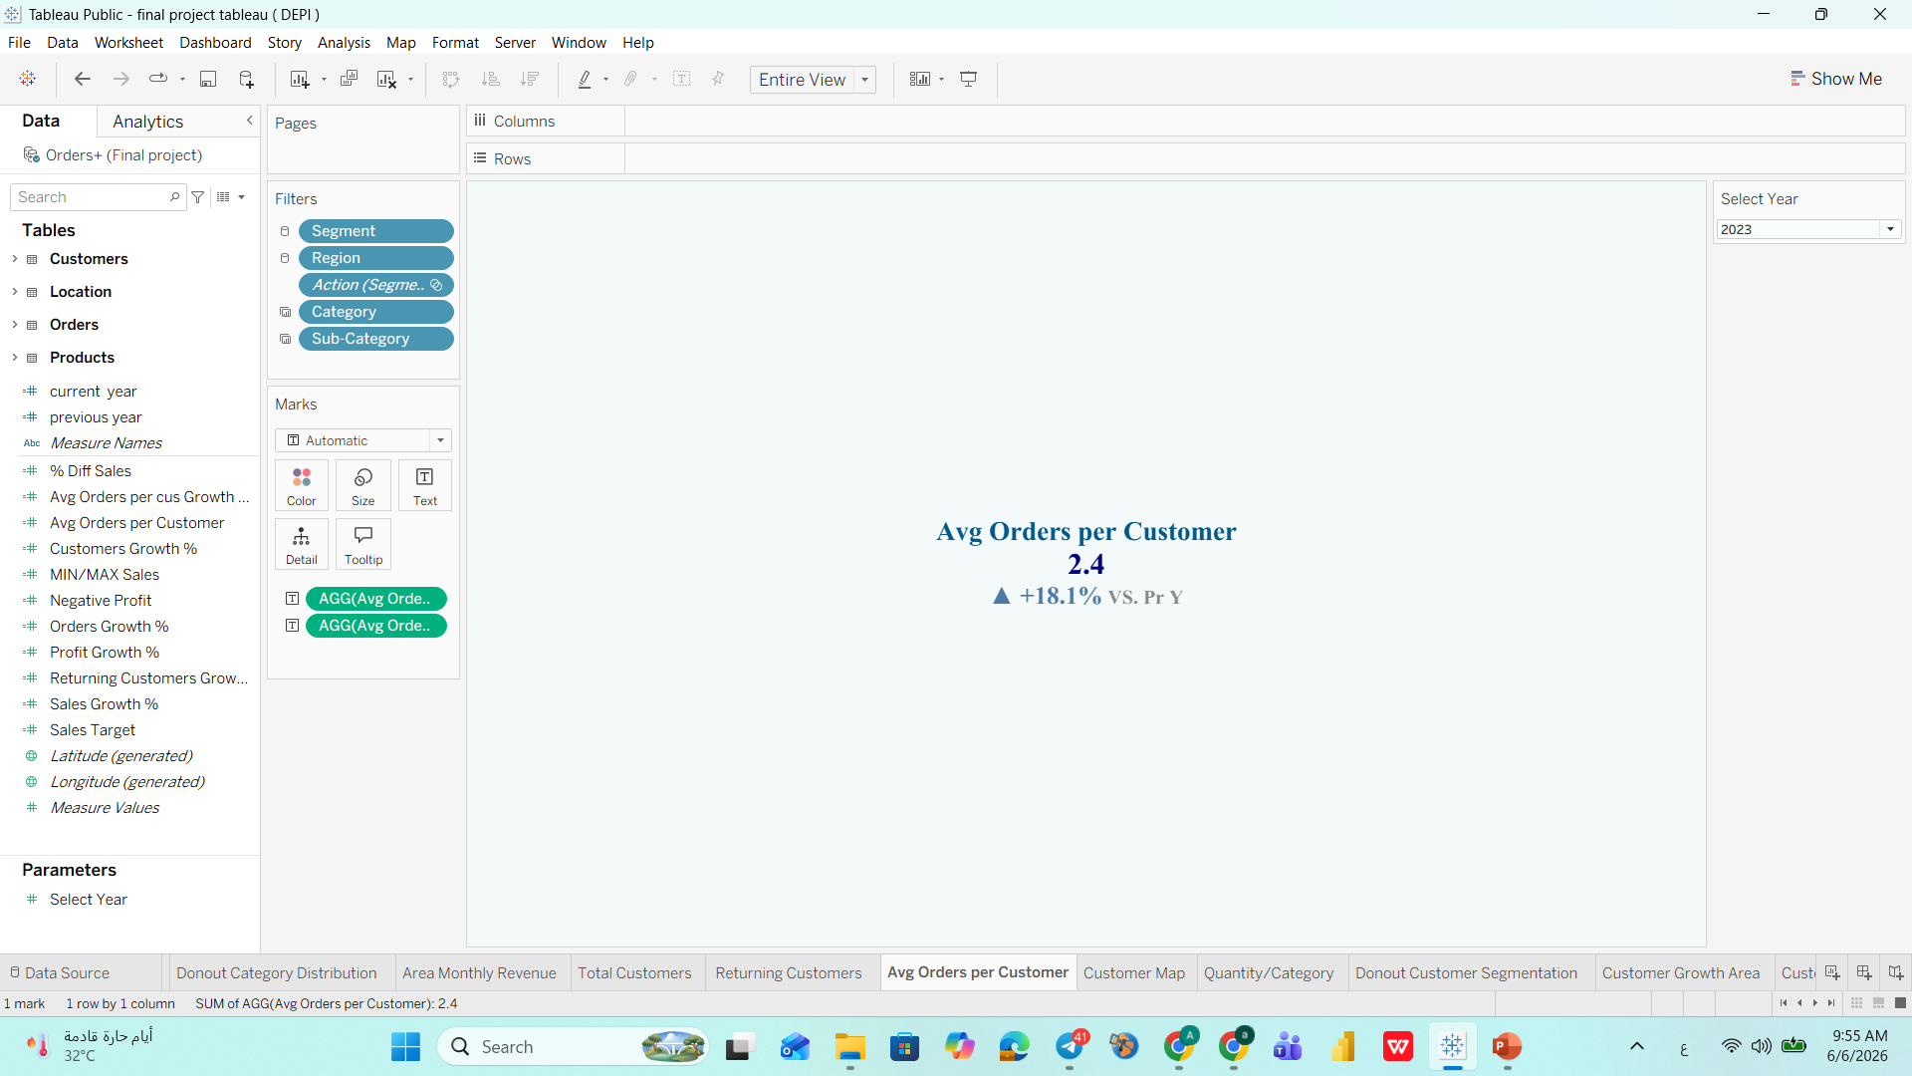
Customer KPIs — Avg Orders Per Customers KPI Card
Business Question
How frequently are customers purchasing, and is engagement increasing?
Answer
Each customer places an average of 2.4 orders in 2023, up +18.1% compared to 2022 — the fastest-growing KPI across all dashboards.
Insight
Customers are buying more frequently within the year compared to the prior year. However, at 2.4 orders per customer, the average is still relatively low — meaning there is significant room to drive repeat purchases within the same year.
Recommendation
Use the growing order frequency as an upsell opportunity. Introduce product recommendations at checkout, send targeted follow-up emails after first purchase, and create bundle offers to encourage customers to place a second or third order within the year.
Notes:
The line chart reveals a classic retail seasonality pattern. February is the weakest month at only $20K — less than 18% of the peak November figure. The March recovery to $59K suggests demand is latent, not permanently lost. Q4 shows the strongest performance, consistent with holiday purchasing. Management should invest in February promotions and capitalize on the November peak with adequate inventory planning.

Slide 30
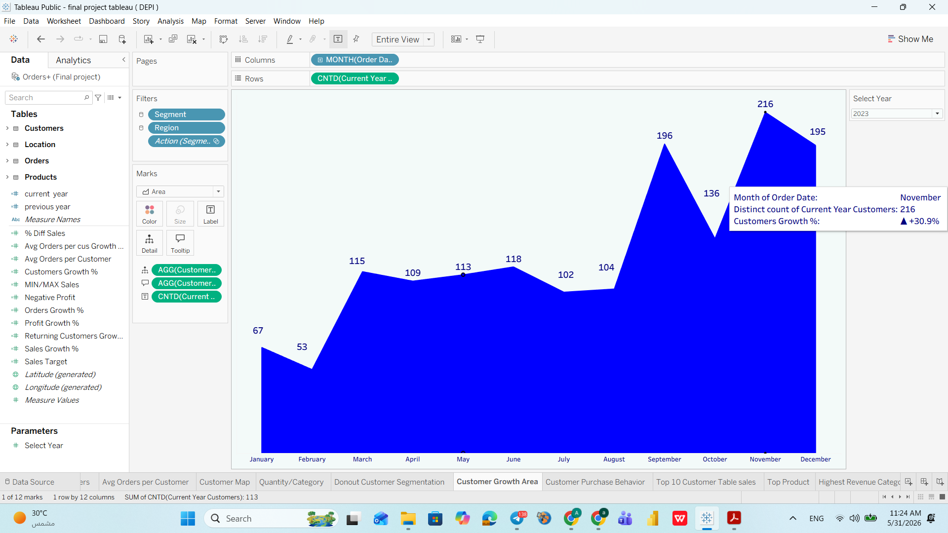
Customer Growth Area Chart — Monthly Customer Acquisition Trend
Business Question
How does the number of active customers fluctuate month to month?
Answer
Customer activity peaks in November (216 customers) and bottoms in February (53) — mirroring the sales trend exactly.
Insight
Customer activity is as seasonal as revenue. February's low count is not just a sales problem — it's a customer engagement problem.
Recommendation
Design a February re-engagement campaign targeting dormant customers with personalized offers. Use November's successful tactics as a template for off-peak months.
Notes:
The line chart reveals a classic retail seasonality pattern. February is the weakest month at only $20K — less than 18% of the peak November figure. The March recovery to $59K suggests demand is latent, not permanently lost. Q4 shows the strongest performance, consistent with holiday purchasing. Management should invest in February promotions and capitalize on the November peak with adequate inventory planning.

Slide 31
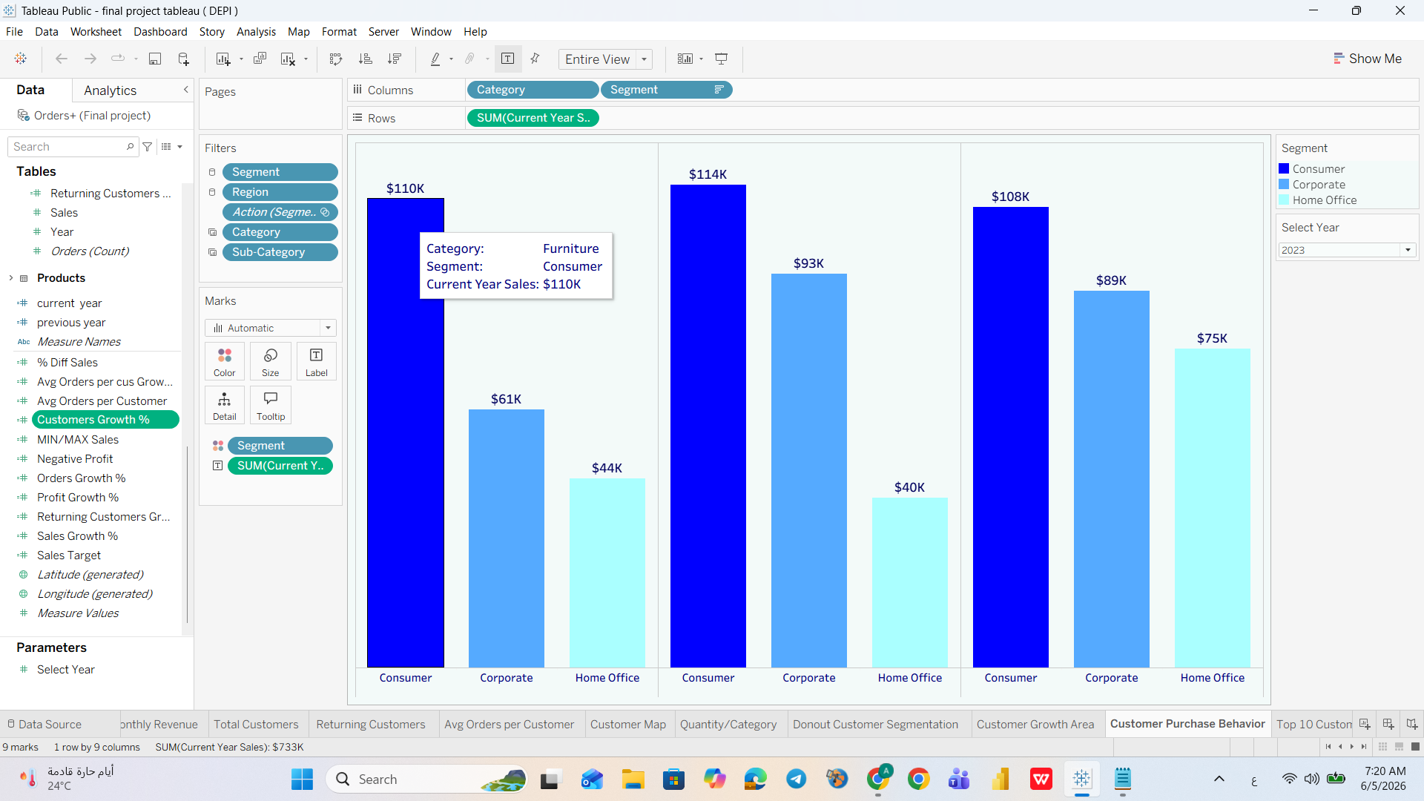
Customer Purchase Behavior — Segment Analysis by Sales
Business Question
Which combination of product category and customer segment generates the most revenue?
Answer
Consumer dominates in all three categories. Technology + Consumer is the highest-value combination. Home Office is consistently the smallest block.
Insight
Consumer segment drives most revenue. Corporate is underutilized — especially in Furniture and Office Supplies, which are natural B2B fits. Home Office is small but fastest-growing.
Recommendation
Build a dedicated B2B sales team for Corporate clients in Furniture and Office Supplies. Create Home Office starter kits — a permanent post-pandemic trend.
Notes:
The line chart reveals a classic retail seasonality pattern. February is the weakest month at only $20K — less than 18% of the peak November figure. The March recovery to $59K suggests demand is latent, not permanently lost. Q4 shows the strongest performance, consistent with holiday purchasing. Management should invest in February promotions and capitalize on the November peak with adequate inventory planning.

Slide 32
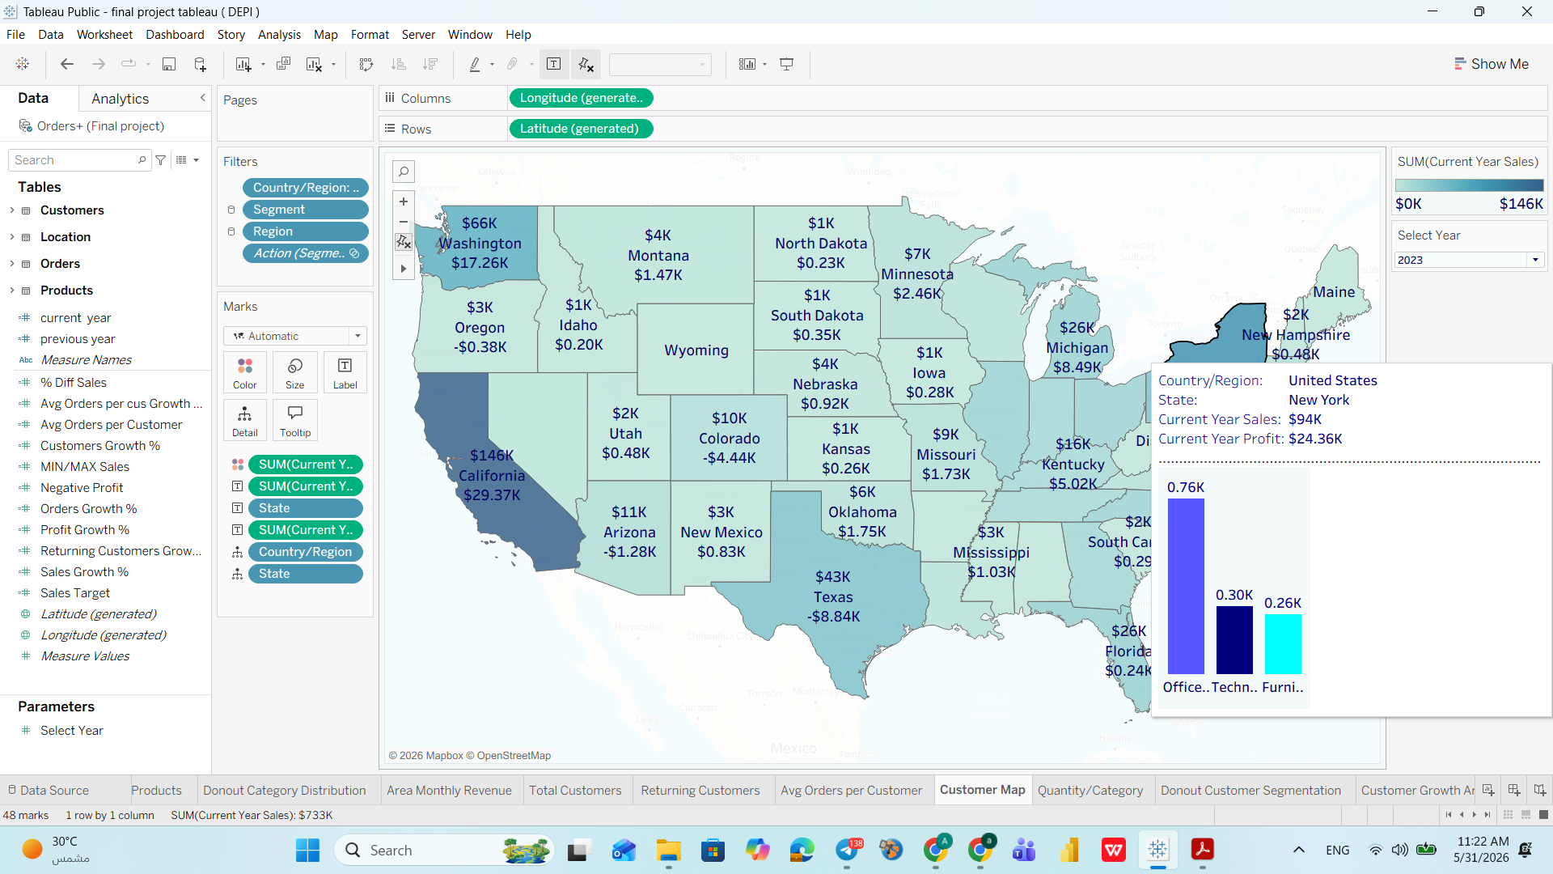
Customer Geographic Map — Quantity/Category by US State
Business Question
Which states generate the most revenue and profit, and which states are losing money?
Answer
California leads with $146K sales and $29.4K profit. Texas (-$8.84K), Colorado (-$4.44K), and Oregon (-$0.38K) operate at a net loss.
Insight
Three states actively destroy profit — likely due to excessive discounting, high logistics costs, or poor product mix. California's dominance is also a concentration risk.
Recommendation
Conduct an urgent pricing and logistics audit in TX, CO, OR. Set minimum order values for high-cost delivery areas. If losses persist after 2 quarters, limit operations.
Notes:
The line chart reveals a classic retail seasonality pattern. February is the weakest month at only $20K — less than 18% of the peak November figure. The March recovery to $59K suggests demand is latent, not permanently lost. Q4 shows the strongest performance, consistent with holiday purchasing. Management should invest in February promotions and capitalize on the November peak with adequate inventory planning.

Slide 33
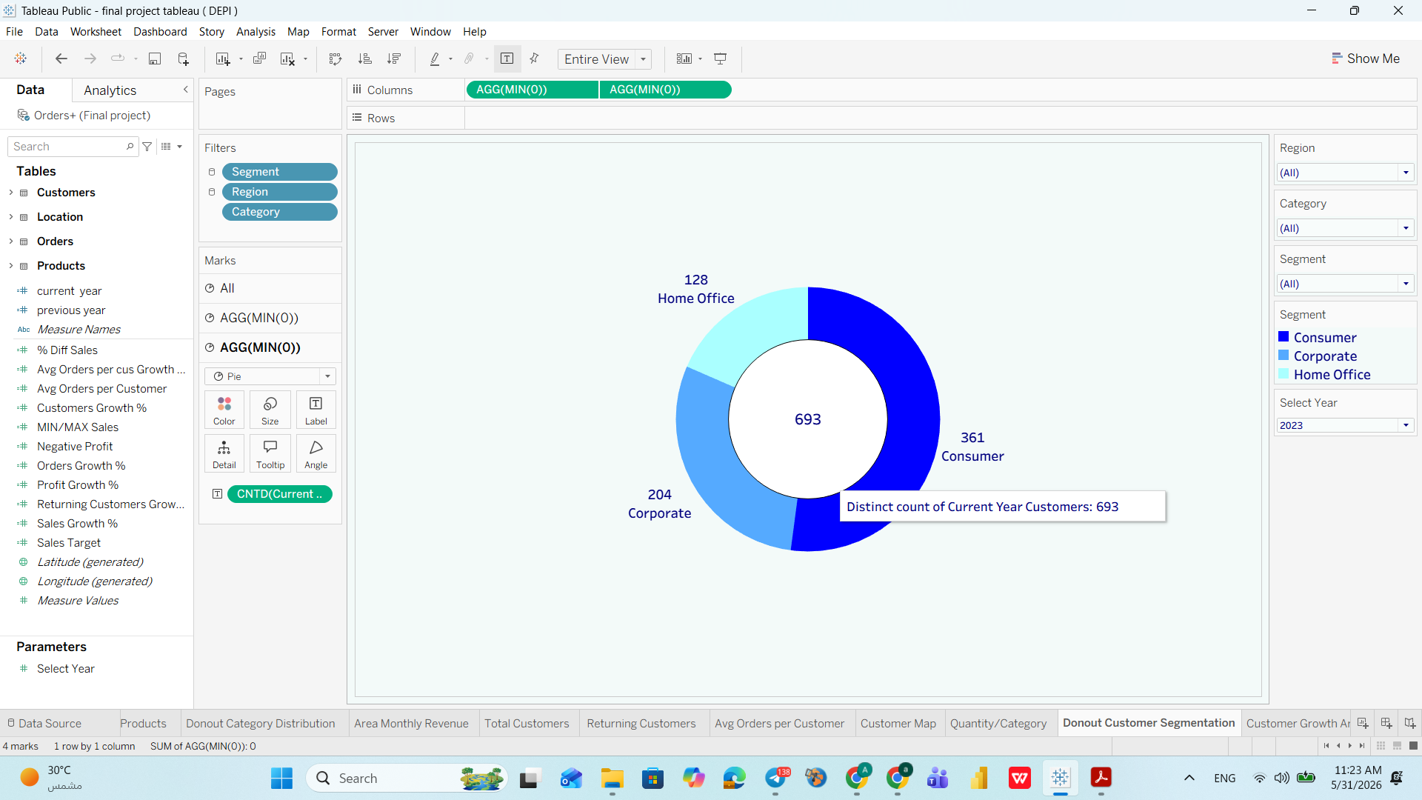
Donut Customer Segmentation
Business Question
How is the customer base distributed across the three segments?
Answer
Consumer: 361 (52%) | Corporate: 204 (29%) | Home Office: 128 (18%). Total: 693 customers.
Insight
Over-reliance on Consumer creates concentration risk. Corporate offers higher average order values but is underserved. Home Office is small but structurally growing.
Recommendation
Rebalance the segment mix: grow Corporate from 29% to 35% over 24 months via B2B account management. Develop a dedicated Home Office product line.
Notes:
The line chart reveals a classic retail seasonality pattern. February is the weakest month at only $20K — less than 18% of the peak November figure. The March recovery to $59K suggests demand is latent, not permanently lost. Q4 shows the strongest performance, consistent with holiday purchasing. Management should invest in February promotions and capitalize on the November peak with adequate inventory planning.

Slide 34
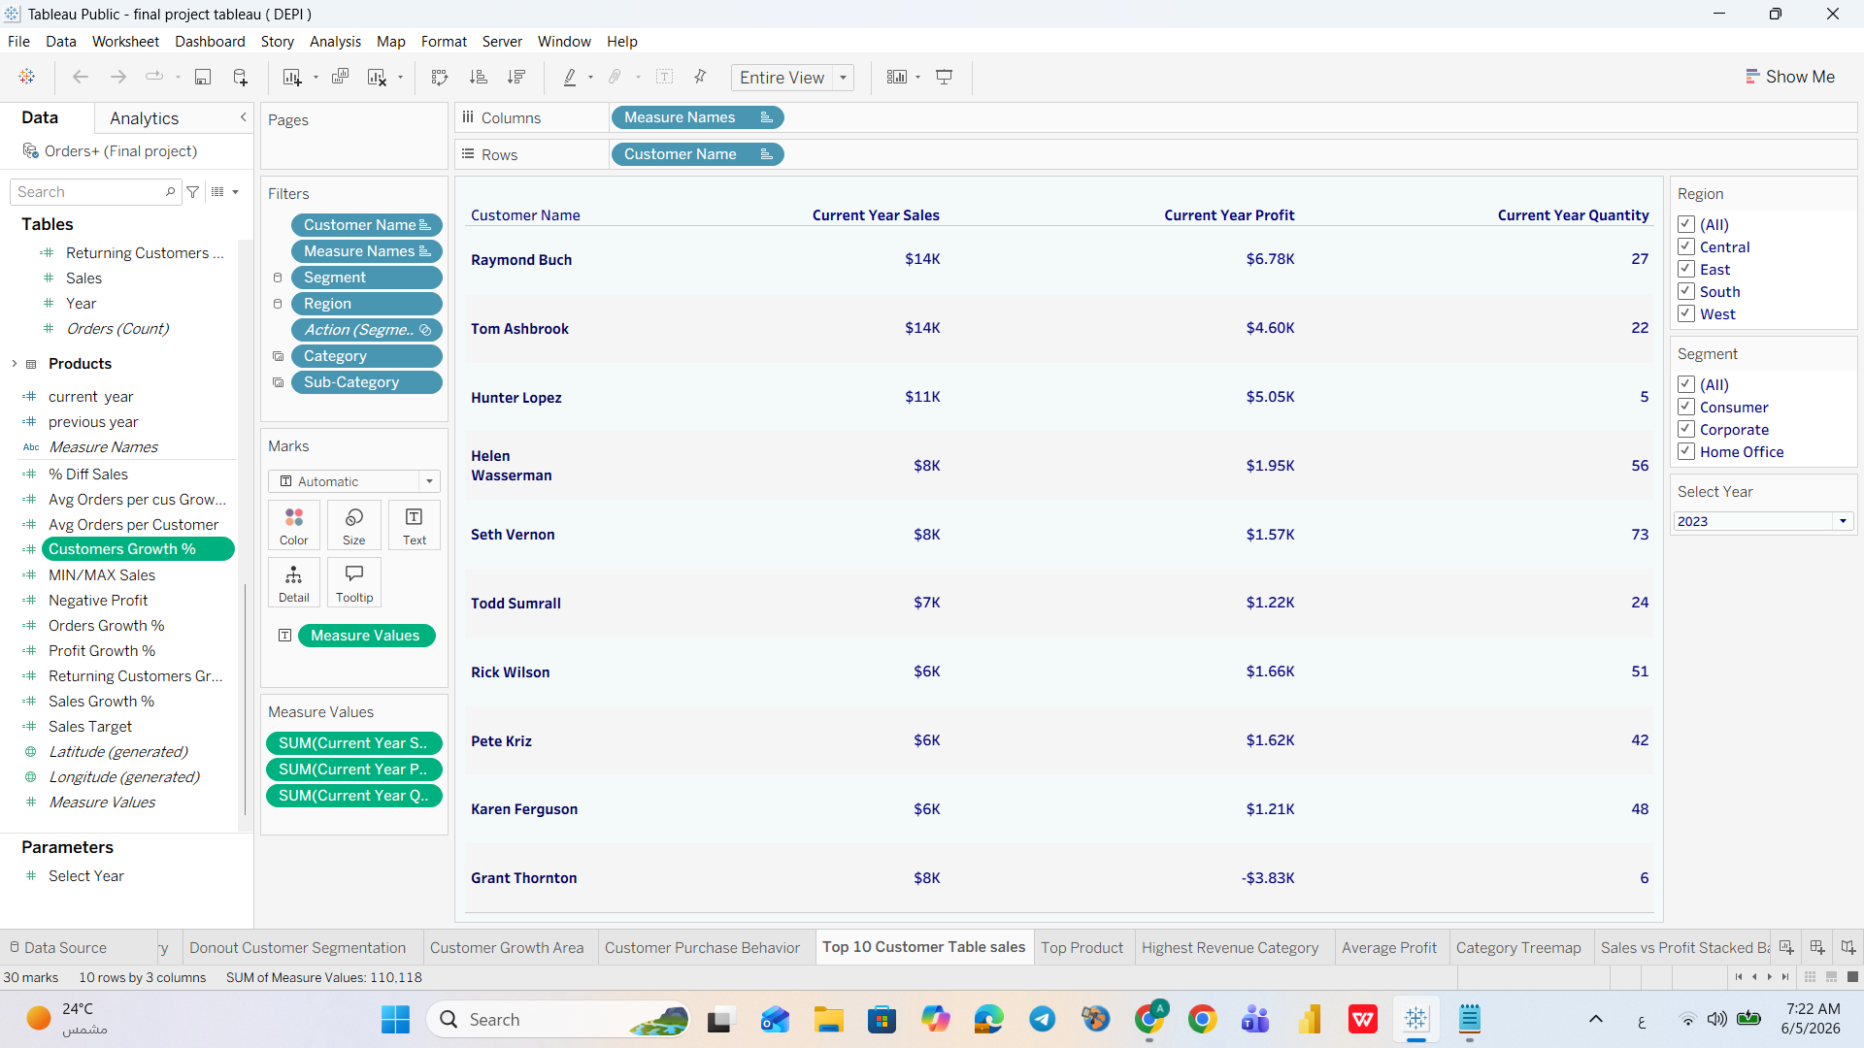
Top 10 Customers Table Sales
Business Question
Who are the highest-value customers, and are they all profitable?
Answer
Raymond Buch and Tom Ashbrook top the list at $14K each. Grant Thornton generates $8K in sales but -$3.83K in profit — a net loss account.
Insight
Not all top customers are profitable. Grant Thornton costs money to serve. Seth Vernon, with 73 orders, represents an untapped VIP loyalty opportunity.
Recommendation
Immediately renegotiate or exit Grant Thornton. Create a VIP program for high-frequency buyers like Seth Vernon. Proactively identify other negative-margin accounts.
Notes:
The line chart reveals a classic retail seasonality pattern. February is the weakest month at only $20K — less than 18% of the peak November figure. The March recovery to $59K suggests demand is latent, not permanently lost. Q4 shows the strongest performance, consistent with holiday purchasing. Management should invest in February promotions and capitalize on the November peak with adequate inventory planning.

Slide 35
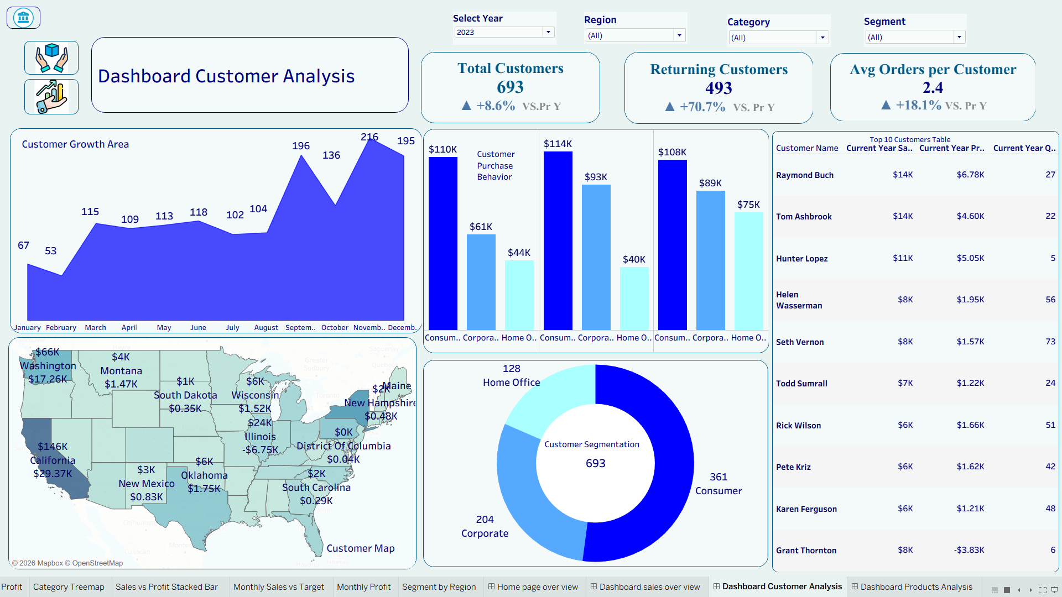
Dashboard Customer Analysis — Complete View (2023)
Notes:
The Customer Analysis dashboard provides a 360-degree view of customer performance. Three KPI cards at the top show Total Customers (693), Returning Customers (781), and Average Orders per Customer (6.32). Below these are five visualizations: a monthly customer growth area chart, a purchase behavior grouped bar chart, a US state map, a customer segmentation donut, and a top-10 customers table. All visuals respond to Year, Region, Category, and Segment filters.

Slide 36
05 | Dashboard Products Analysis
Product KPIs · Treemap · Sales vs Target · Monthly Profit
Notes:
Section five covers the Products Analysis dashboard — our third and final dashboard. This section goes deep into product-level performance, including profitability by sub-category, revenue hierarchy, and sales target tracking.

Slide 37
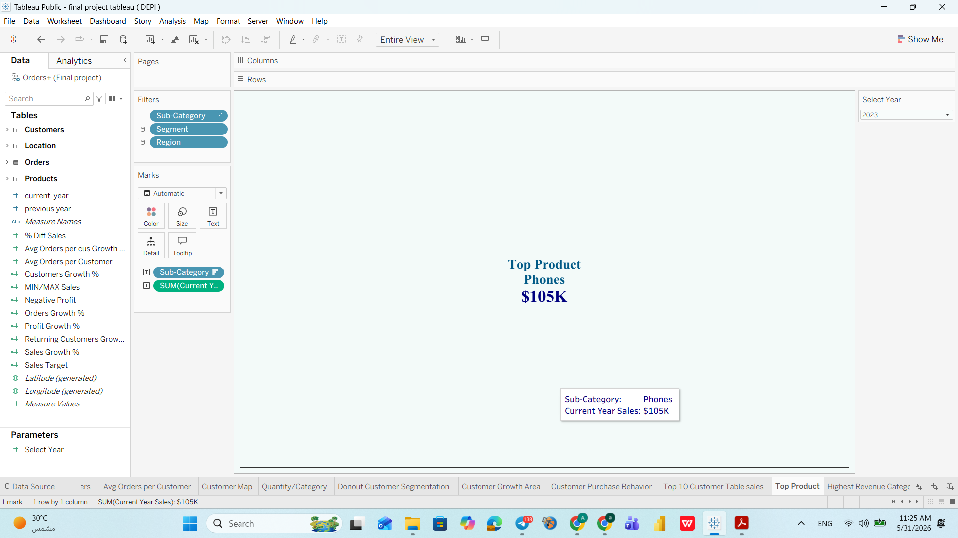
Products KPIs — Top Product KPI Card
Business Question
Which sub-category is generating the highest revenue?
Answer
Phones lead all 17 sub-categories with $105K in sales in 2023 — by a significant margin.
Insight
Phones are the single most important revenue driver at sub-category level. Their dominance justifies prioritizing stock, supplier negotiations, and cross-sell strategies.
Recommendation
Negotiate volume discounts with phone suppliers. Bundle phones with high-margin accessories (cases, chargers, warranties) to increase per-transaction value.
Notes:
The line chart reveals a classic retail seasonality pattern. February is the weakest month at only $20K — less than 18% of the peak November figure. The March recovery to $59K suggests demand is latent, not permanently lost. Q4 shows the strongest performance, consistent with holiday purchasing. Management should invest in February promotions and capitalize on the November peak with adequate inventory planning.

Slide 38
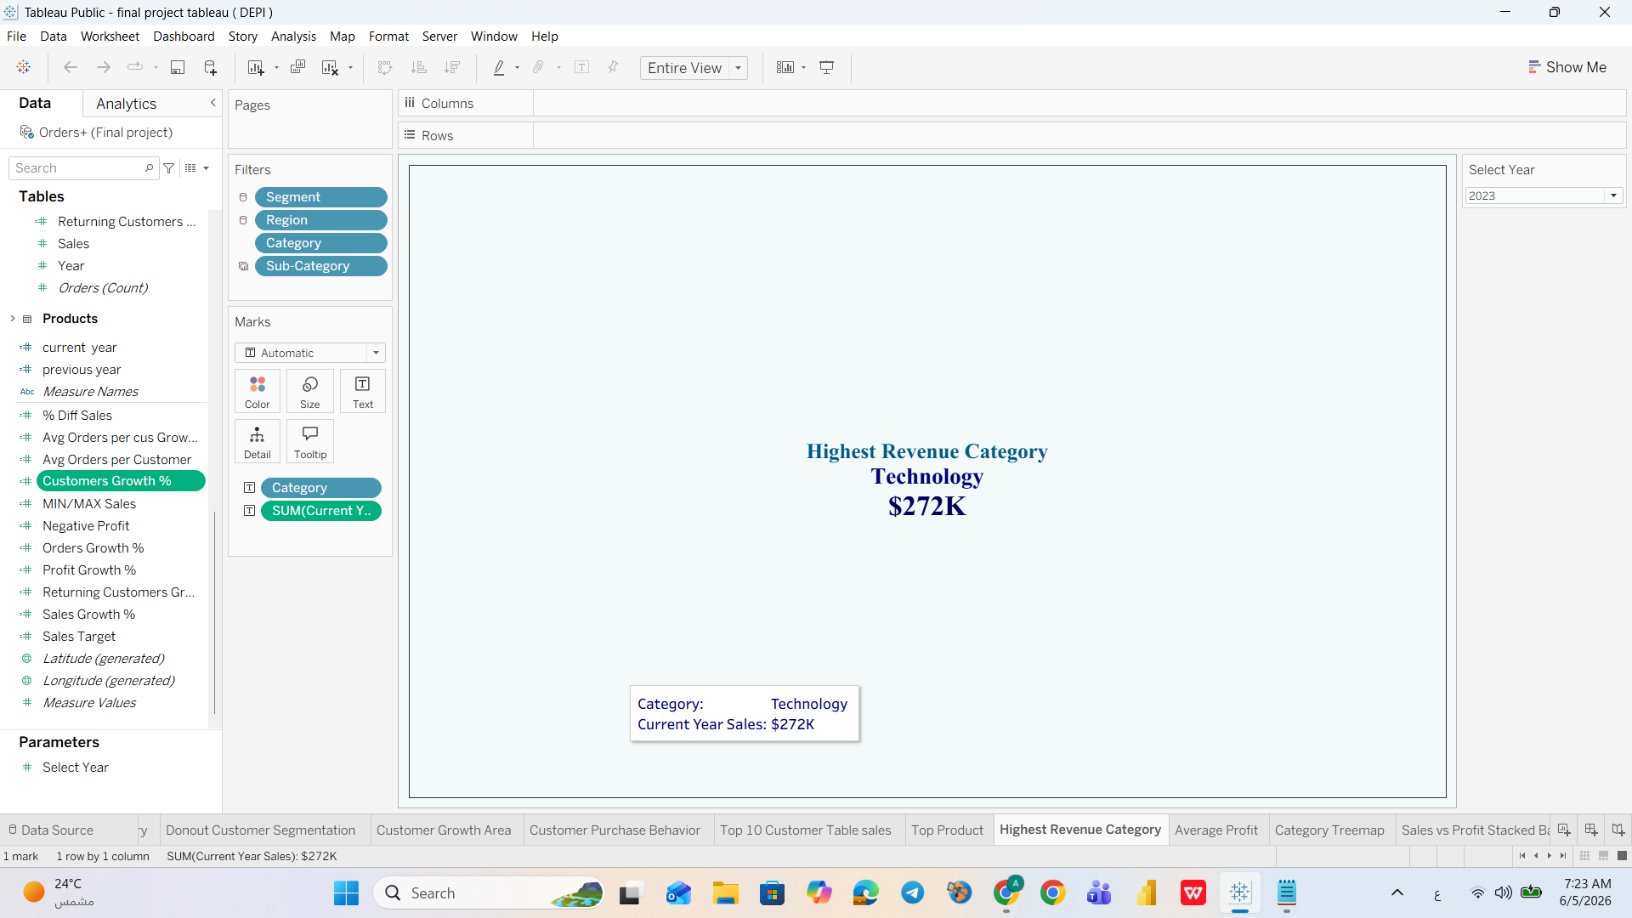
Products KPIs — Highest Revenue Category KPI Card
Business Question
Which product category leads in total revenue?
Answer
Technology generates $272K — the top category at 37% of all sales, driven by Phones and Copiers.
Insight
Copiers have the highest profit-to-sales ratio in the entire dataset, making Technology not just the revenue leader but also a key profit contributor.
Recommendation
Increase focus on Copiers as a strategic growth product. Allocate more marketing budget to Technology bundles (Phone + Accessories + Support contracts).
Notes:
The line chart reveals a classic retail seasonality pattern. February is the weakest month at only $20K — less than 18% of the peak November figure. The March recovery to $59K suggests demand is latent, not permanently lost. Q4 shows the strongest performance, consistent with holiday purchasing. Management should invest in February promotions and capitalize on the November peak with adequate inventory planning.

Slide 39
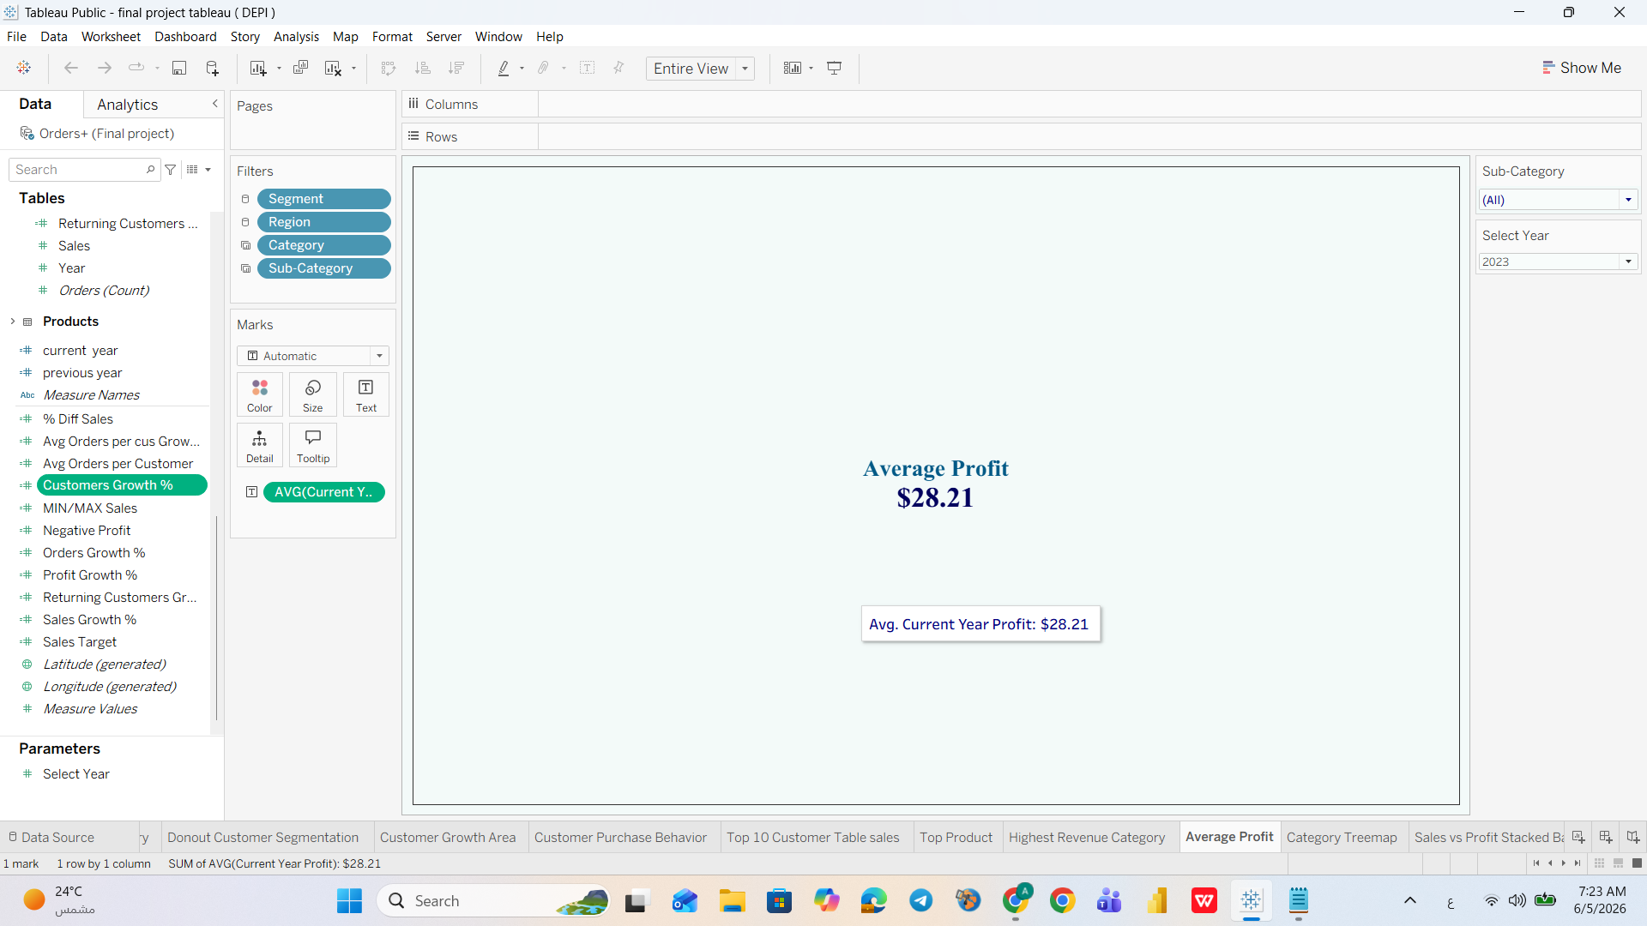
Products KPIs — Average Profit KPI Card
Business Question
How much profit does the business earn on an average order?
Answer
Average profit per order is $28.21, against an average order value of ~$434 — a margin of approximately 6.5%.
Insight
A 6.5% average margin is thin. Any increase in discounting, shipping costs, or returns can easily push individual orders into loss territory.
Recommendation
Set an initial minimum 10% profit margin floor per order (current avg: 6.5%), targeting 15% within 18 months. Remove discounts on high-demand products like Phones and Chairs where demand is inelastic. Target $35+ average profit per order within 12 months.
Notes:
The line chart reveals a classic retail seasonality pattern. February is the weakest month at only $20K — less than 18% of the peak November figure. The March recovery to $59K suggests demand is latent, not permanently lost. Q4 shows the strongest performance, consistent with holiday purchasing. Management should invest in February promotions and capitalize on the November peak with adequate inventory planning.

Slide 40
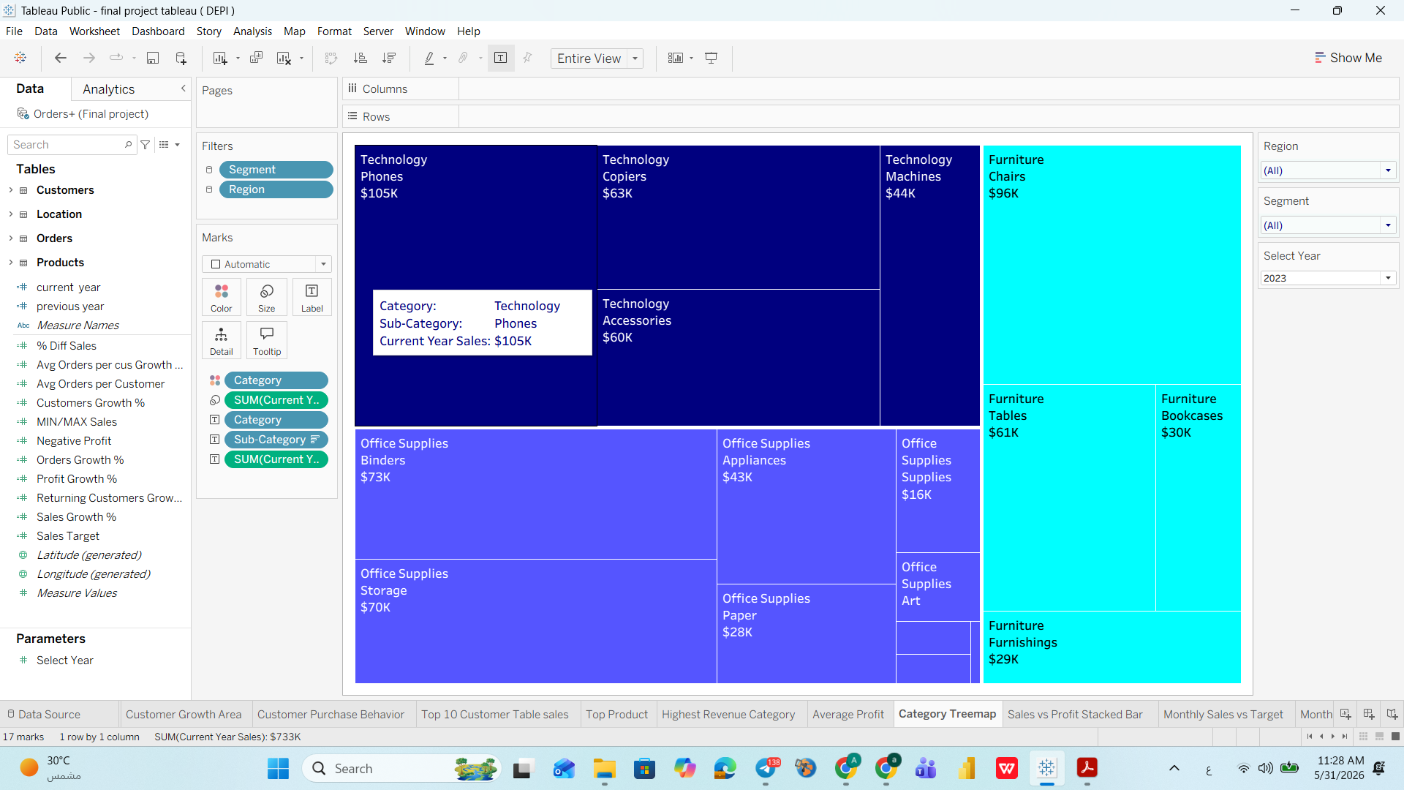
Tree map — Category & Sub-Category Hierarchy
Business Question
What does the full product portfolio look like in terms of relative sales contribution?
Answer
Phones ($105K) is the largest box. Chairs ($96K) and Binders ($73K) follow. Tables, Fasteners, and Envelopes are nearly invisible.
Insight
Extreme imbalance in the product portfolio — a handful of sub-categories drive most revenue. The Treemap shows sales size only; Tables ($61K) looks significant here, but cross-referencing with the Sales vs Profit chart reveals it is profit-negative — the Treemap alone is misleading for Tables.
Recommendation
Use the treemap as a portfolio rationalization tool. Any sub-category too small to read should be evaluated for discontinuation. Reprice or eliminate Tables entirely.
Notes:
The line chart reveals a classic retail seasonality pattern. February is the weakest month at only $20K — less than 18% of the peak November figure. The March recovery to $59K suggests demand is latent, not permanently lost. Q4 shows the strongest performance, consistent with holiday purchasing. Management should invest in February promotions and capitalize on the November peak with adequate inventory planning.

Slide 41
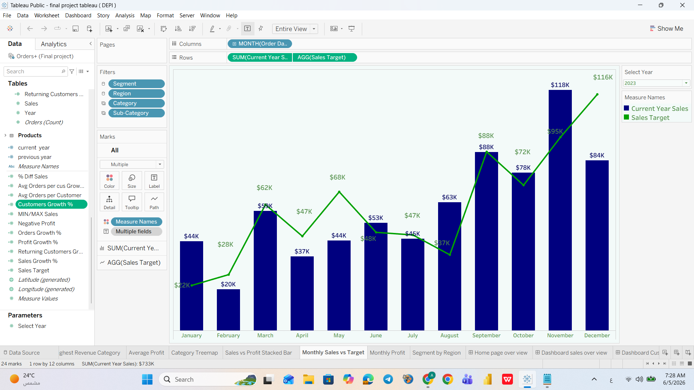
Monthly Sales vs. Target — Gap Analysis (2023)
Business Question
Is the business hitting its monthly sales targets, and where are the biggest gaps?
Answer
The company had mixed target performance in 2023. Five months exceeded their targets: January ($44K vs $22K), June ($53K vs $48K), September ($63K vs $37K), October ($88K vs $72K), and November ($118K vs $95K). Four months significantly missed: February ($20K vs $28K), March ($59K vs $62K), May ($44K vs $68K), and December ($84K vs $116K).
Insight
Performance is polarized: Q1 and Q2 show the worst misses (May gap = -$24K), while Q3 and Q4 show the strongest outperformance. The pattern suggests seasonal demand is not yet matched by seasonal planning.
Recommendation
Pre-plan inventory and campaigns for Q1/Q2 where misses are concentrated. Investigate what drives Q3/Q4 outperformance (Sep +$26K above target) and replicate those conditions earlier in the year. Implement monthly target reviews with automated alerts.
Notes:
The line chart reveals a classic retail seasonality pattern. February is the weakest month at only $20K — less than 18% of the peak November figure. The March recovery to $59K suggests demand is latent, not permanently lost. Q4 shows the strongest performance, consistent with holiday purchasing. Management should invest in February promotions and capitalize on the November peak with adequate inventory planning.

Slide 42
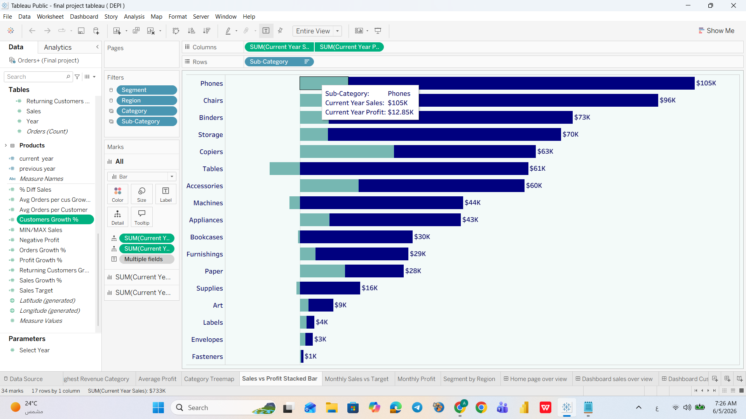
Sales vs. Profit per Sub-Category
Business Question
For each sub-category, how does profit compare to sales — which are truly profitable?
Answer
Phones, Chairs, and Copiers show strong profit bars. Tables has a near-zero or negative profit bar. Bottom sub-categories show both low sales and low profit.
Insight
This chart exposes the 'revenue illusion' — Tables looks valuable in sales but destroys margin. Copiers deliver a much higher profit-to-sales ratio than Phones.
Recommendation
Rank sub-categories by profit margin, not just sales. Invest in growing Copiers. Immediately address Tables. Evaluate bottom sub-categories for bundling or discontinuation.
Notes:
The line chart reveals a classic retail seasonality pattern. February is the weakest month at only $20K — less than 18% of the peak November figure. The March recovery to $59K suggests demand is latent, not permanently lost. Q4 shows the strongest performance, consistent with holiday purchasing. Management should invest in February promotions and capitalize on the November peak with adequate inventory planning.

Slide 43
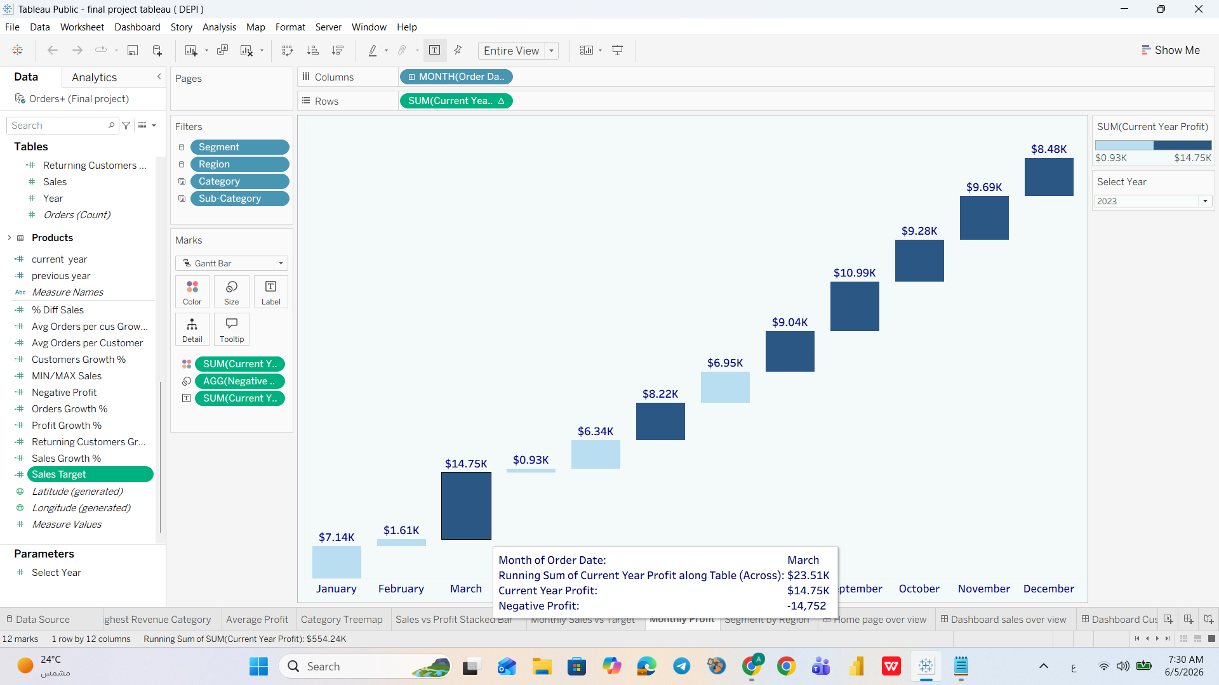
Monthly Profit Waterfall Chart — Profit Distribution Across 2023
Business Question
How does profit accumulate month by month, and are there months where it declines?
Answer
Total 2023 profit = $93K. December is the highest single month ($8.48K), March the strongest mid-year contributor ($14.75K). April drops to $0.93K and August slows to $6.95K — confirming mid-year fragility. Most months are profitable (dark navy); light blue bars mark the weakest months.
Insight
Profit momentum is fragile in certain months — particularly mid-year. A single bad month can erase weeks of accumulated gains. Q4 is where most profit is built.
Recommendation
Protect mid-year profit by reducing unnecessary discounting in June-August. Build financial buffers during Q4 peaks to cushion Q1 softness. Use this chart to catch erosion early.
Notes:
The line chart reveals a classic retail seasonality pattern. February is the weakest month at only $20K — less than 18% of the peak November figure. The March recovery to $59K suggests demand is latent, not permanently lost. Q4 shows the strongest performance, consistent with holiday purchasing. Management should invest in February promotions and capitalize on the November peak with adequate inventory planning.

Slide 44
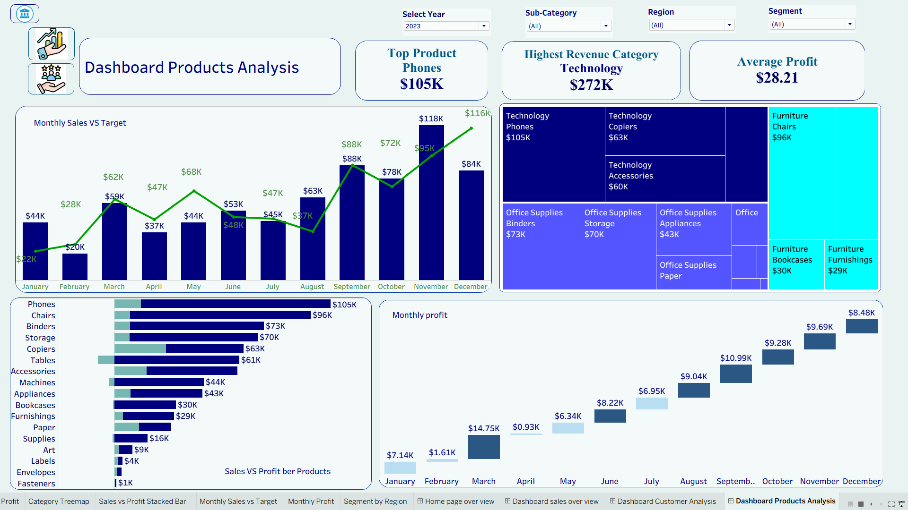
Dashboard Products Analysis — Complete View (2023)
Notes:
The Products Analysis dashboard contains three KPI cards: Top Product (Phones $105K), Highest Revenue Category (Technology $272K), and Average Profit ($28.21). The four charts below show: Monthly Sales vs Target (combo bar-line), Revenue Treemap, Sales vs Profit per Sub-Category (dual horizontal bar), and Monthly Profit waterfall chart. Filters for Year, Region, and Segment are available at the top.

Slide 45
06 | Key Findings & Insights
Sales · Customer · Product · Regional · Temporal
Notes:
Section six consolidates the most important discoveries across all three dashboards into a structured findings presentation.

Slide 46
Key Findings — Sales Performance (2023)
📈 Best Year on Record
High
🎯 Mixed Target Performance
Critical
2023 achieved $733K in sales, $93K in profit, and 1,687 orders — all-time highs across every KPI, confirming strong business momentum.
Performance is split: 5 months exceeded targets (Jan, Jun, Sep, Oct, Nov) and 4 months significantly missed (Feb, Mar, May, Dec). Q3 and Q4 consistently outperform while Q1/Q2 underperform. February is the worst miss (-$8K gap) and May the largest proportional miss (-$24K gap).
💻 Technology Dominance
Medium
🔺 Revenue Growth Gap
Critical
Technology leads at $272K (37% of revenue), Office Supplies at $246K (34%), Furniture at $215K (29%). This balance is healthy but masks the loss-making Tables sub-category.
Sales grew +20.4% but profit only grew +14.2%, while orders surged +28.3%. This divergence signals declining order value and potential discounting pressure.
📅 Extreme Seasonality
High
🗺️ Regional Inequality
High
Revenue swings from $20K (February) to $118K (November) — a 490% variance. May gap vs previous year is the largest — something worked exceptionally well. August dip recurs both years — a predictable pattern to plan around.
West Consumer ($107K) is the single highest performing combination. Corporate strongest in West ($86K) — B2B opportunity in other regions. South weakest overall (~$105K total). Central Home Office ($30K) completely untapped — a clear expansion opportunity.
Notes:
These six sales findings represent the most important discoveries from the Sales Overview dashboard. The two Critical findings — the revenue-profit growth divergence and the consistent target misses — should be the primary agenda items at the next executive review. The High findings around seasonality and regional inequality are addressable through targeted campaigns and investment.

Slide 47
Key Findings — Customer Behavior & Product Performance
👥 Customer Behavior Findings
📦 Product Performance Findings
▶ Consumer segment (52%) dominates all categories — Technology + Consumer combination alone generates $114K in revenue
▶ Phones ($105K) lead all 17 sub-categories; Chairs ($96K) and Binders ($73K) follow closely
▶ Returning customers (493, customers with 2+ orders within 2023) show strong in-year loyalty — new acquisition at only +8.6% YoY still needs acceleration
▶ Tables sub-category generates $61K in sales but is profit-negative — actively destroying margin
▶ Average orders per customer grew +18.1% to 2.4 orders in 2023 — customers buying more frequently within the year, with significant room to drive further repeat purchases
▶ Copiers have the highest profit-to-sales ratio in the entire dataset — a strategic priority product
▶ California ($146K, +$29K profit) is the top state; Texas (-$8.84K), Colorado (-$4.44K) are loss-making — geographic concentration risk
▶ Average profit $28.21/order on ~$434 avg order value = ~6.5% margin — within range but needs improvement, especially in loss-making states
▶ Grant Thornton generates $8K sales at -$3.83K profit — an account that costs money to serve; requires reprice or exit
▶ Office Supplies has most SKUs but only 34% category share — fragmented, low-value products; consider reducing bottom SKUs
▶ No single customer exceeds 2% of revenue — healthy distribution; top customer Seth Vernon placed 73 orders — VIP program opportunity
▶ Home Office (18%) is smallest but fastest-growing post-pandemic — remote work trend is permanent; create dedicated home office bundles
Notes:
This slide consolidates critical customer and product insights. The customer loyalty finding is very positive — the company is excellent at retaining customers. However, the individual account-level analysis reveals that some accounts are loss-making. On the product side, Tables being profit-negative is a structural problem that requires immediate action. Copiers being the most efficient product suggests the company should actively promote them in corporate bundles.

Slide 48
07 | Strategic Recommendations
Data-Driven Actions for Business Growth & Performance Optimization
Notes:
Section seven translates our analytical findings into ten strategic recommendations. Each recommendation is grounded in specific data points from the three dashboards.

Slide 49
Strategic Recommendations — Part 1: Revenue & Growth
Seasonal Sales Campaigns
01
Trigger: February revenue ($20K) is 83% below November peak ($118K); August actual ($47K) misses its $63K target — both are recurring low-performance periods confirmed in the data Action: Launch 'New Year, New Office' campaign in February targeting Consumer and Corporate with bundle offers. Run annual 'Back to Business' promotion in August. Pre-negotiate bulk corporate orders in July for August delivery.
KPI: Increase February revenue from $20K to $40K and eliminate August target miss within 12 months
Close the Target Gap
02
Trigger: 5 months exceeded targets (Jan, Jun, Sep, Oct, Nov); 4 months significantly missed (Feb, Mar, May, Dec). The May gap (-$24K) is the single largest miss. Q1/Q2 is where performance consistently falls short. Action: Validate whether the Prior Year ×1.20 growth multiplier used for targets is realistic given actual growth rates. For Q1/Q2 months where misses are largest (May: -$24K, Feb: -$8K), investigate root causes — is it demand, stock availability, or marketing gaps? Implement weekly sales performance monitoring with automated alerts.
KPI: Achieve ≥90% of monthly target attainment across all 12 months within 2 quarters; eliminate the May and February gaps within the first quarter
Geographic Expansion — South & Central
03
Trigger: West generates $250K vs South's $105K — 2.4× gap Action: Invest marketing budget in high-population underpenetrated states in South (Florida, North Carolina) and Central (Illinois — after fixing profitability, Georgia). Partner with regional distributors to reduce logistics costs in these regions. Study what makes West outperform and transfer those pricing and product-mix strategies to South and Central.
KPI: Grow South + Central combined from $251K to $320K within 18 months
Resolve Negative-Profit States
04
Trigger: Texas (-$8.84K), Colorado (-$4.44K), Oregon (-$0.38K) lose money despite decent sales — discounting and logistics costs exceed gross margin Action: Conduct full pricing and discount audit in Texas, Colorado, Oregon. Investigate shipping/logistics costs eating profit. Introduce minimum order values for high-cost delivery areas. If losses persist after 2 quarters — consider limiting operations.
KPI: Achieve breakeven (≥0 profit) in all three states within 6 months
Notes:
These first four recommendations target the most urgent revenue and growth opportunities. The February campaign addresses seasonality. The target-gap resolution requires both operational and planning improvements. Geographic expansion into underperforming regions is a significant growth lever. And fixing the negative-profit states stops the bleeding immediately.

Slide 50
Strategic Recommendations — Part 2: Customer & Product
Customer Loyalty & Retention Program
05
Trigger: 493 returning customers (within-year buyers); avg orders/customer +18.1% to 2.4 orders in 2023 — loyalty is growing but not yet fully monetized Action: Launch tiered loyalty program with points system. Create VIP tier for customers with 10+ orders/year (e.g. Seth Vernon: 73 orders). Use purchase history for personalized recommendations. Consider annual subscription model for high-frequency buyers. To accelerate acquisition: launch referral program, offer first-order discount for new customers, set quarterly new customer acquisition target of minimum 15% growth.
KPI: Sustain returning customer YoY growth at ≥30% (currently +70.7%); grow new customer acquisition rate from +8.6% to +15% per quarter; increase avg orders per customer from 2.4 to 3.5 within 12 months
Eliminate Loss-Making Products & Accounts
06
Trigger: Tables sub-category is profit-negative; Grant Thornton: $8K sales but -$3.83K profit — net loss customer requiring urgent review Action: Reprice Tables by 15-20% or discontinue. Review Grant Thornton pricing — renegotiate or exit. For Fasteners/Envelopes/Labels: calculate true profitability including storage, handling, shipping costs — if unprofitable discontinue and reallocate warehouse space; if marginal, bundle with high-demand products.
KPI: Tables: breakeven within 2 quarters via repricing. Grant Thornton: renegotiate or exit within 30 days. All loss-making sub-categories: reach positive profit within 3 quarters.
Discount Reduction & Margin Optimization
07
Trigger: Average profit of $28.21/order indicates thin margins across the portfolio Action: Conduct full discount audit — identify products/customers with excessive discounts. Set an initial minimum 10% profit margin floor per order (current avg: 6.5%), targeting 15% within 18 months. Remove discounts on high-demand products (Phones, Chairs) where demand is inelastic. Introduce tiered pricing for volume buyers to protect margin at scale.
KPI: Increase average profit per order from $28.21 to $35+ within 12 months
Cross-Sell Technology + Office Supplies Bundles
08
Trigger: Technology leads in revenue but Office Supplies leads in quantity (7.68K units) Action: Upsell accessories at point of sale (cases, chargers, warranties) with Phones. Create Technology bundles (Phone + Accessories + Support). Focus on higher-margin sub-categories: Copiers and Machines alongside Phones. Negotiate better supplier pricing given high Phone volume.
KPI: Increase average items per order by 25% and achieve a 30% Technology accessory attach rate on Phone orders within 6 months
Notes:
Recommendations five through eight address customer loyalty, product profitability, margin management, and cross-selling. The loyalty program capitalizes on the strong retention trend. Eliminating loss-making products and accounts is non-negotiable. The discount optimization recommendation alone could add $40,000–$60,000 in annual profit if implemented effectively.

Slide 51
Strategic Recommendations — Part 3: Segmentation & Future Growth
Customer Segmentation & Personalization
📌 Trigger: Consumer (52%), Corporate (29%), Home Office (18%) each have distinct needs
🎯 Action: Launch dedicated B2B sales team. Create corporate account packages (bulk pricing, guaranteed margins). Target Furniture + Office Supplies for corporate clients. Offer corporate credit terms (net 30/60). For Home Office: create starter packages, offer home delivery with setup service, partner with HR departments of remote-work companies, and target via digital ads.
📊 KPI Target: Grow Corporate segment contribution from 29% to 35% over 24 months
09
Inventory Optimization for Peak Periods
📌 Trigger: November peaks at $118K but other months average $50-60K — seasonal success not yet replicated across the year
🎯 Action: Analyze what drove November success — replicate strategy in March and June (2nd and 3rd strongest months). Create quarterly 'peak events' instead of relying solely on Q4. Pre-stock Phones, Chairs, Binders before peak months to avoid stockouts.
📊 KPI Target: Increase November revenue to $130K; grow March + June combined by 30%; achieve <2% stockout rate in Q4
10
All 10 recommendations are directly grounded in specific findings from the three interactive dashboards — enabling immediate, evidence-based action.
Notes:
The final two recommendations focus on segment-specific strategies and supply chain preparation for peak periods. Segmentation ensures that each customer type receives the most relevant offer. Inventory optimization using our own dashboard data to forecast Q4 demand is one of the highest-ROI actions the company can take — preventing stockouts during the $118K November peak.

Slide 52
08 | Executive Summary
Main Findings · Critical Insights · Recommendations · Expected Impact
Notes:
The final section brings everything together in a concise executive summary suitable for presentation to senior leadership or academic evaluators.

Slide 53
Executive Summary — Complete Business Intelligence Solution
$733K
$93K
1,687
693
$272K
$105K
Total Sales
Total Profit
Total Orders
Customers
Tech Revenue
Phones
▲ +20.4%
▲ +14.2%
▲ +28.3%
▲ +8.6%
#1 Category
Top Product
🔍 Critical Findings
💡 Key Recommendations
📈 Expected Business Impact
▪ 2023 is best-performing year across all KPIs
▪ Profit growth (14.2%) lags order growth (28.3%)
▪ Mixed target performance: 5 months exceeded targets (Jan, Jun, Sep, Oct, Nov); 4 months significantly missed (Feb, Mar, May, Dec). Largest miss: May (-$24K gap)
▪ 3 states operating at negative profit (TX -$8.84K, CO -$4.44K, OR -$0.38K)
▪ Tables sub-category destroys margin
▪ Corporate segment (29%) underutilized — especially in Furniture; new customer acquisition at only +8.6%
▪ February promotion campaign ($20K → $40K)
▪ Fix negative-profit states (TX, CO, OR) via pricing audit
▪ Discontinue/reprice Tables sub-category
▪ VIP loyalty program targeting 493+ returning customers and high-frequency buyers
▪ Launch referral program + new customer acquisition target of 15% quarterly growth
▪ Replicate November success in March & June; Q4 pre-positioning
▪ +$50K–80K annual revenue from seasonal campaigns
▪ +$20K+ profit from discount reduction & margin floor policy
▪ +$17K–$30K from eliminating confirmed losses in TX (-$8.84K), CO (-$4.44K), OR (-$0.38K) & Grant Thornton (-$3.83K) through pricing optimization
▪ 5–10% increase in customer retention
▪ Reduce February trough by 50%
▪ Achieve 90%+ monthly target attainment
Notes:
The executive summary consolidates every major finding and recommendation onto a single slide. The six KPI metrics at the top confirm 2023 as a record year. The three columns highlight critical findings that require action, our top recommendations prioritized by impact, and the expected business benefits if recommendations are implemented. This slide is designed for C-suite consumption — all the signal, none of the noise.

Slide 54
Business Impact, Challenges & Limitations
🚀 Business Impact
⚠️ Challenges & Limitations
Decision Speed
Data Encoding
Real-time KPI visibility replaced days of manual reporting — decision cycles cut from 3 days to under 60 seconds.
Source files used Latin-1 encoding — manual conversion required before import; future pipelines should enforce UTF-8 as a data standard.
Cost Visibility
Duplicate Records
TX, CO, OR loss zones and profit-negative sub-categories surfaced for the first time — unlocking $17K–$30K in recoverable margin through pricing and logistics optimization.
9,994-row Orders table contained duplicate records — deduplication was mandatory to ensure KPI accuracy and prevent inflated metrics.
Revenue Optimization
No External Benchmarks
Recurring seasonal blind spots (Feb, Aug) identified and quantified — targeted campaigns can recover $50K+ in low-season revenue annually.
All growth rates (e.g. +20.4% sales) are measured internally — without industry benchmarks, it is impossible to assess whether performance is truly competitive.
Customer Intelligence
Loss-making accounts like Grant Thornton (-$3.83K profit on $8K revenue) flagged for repricing — protecting margin at the account level.
Limited Demographics
Target Accountability
Absence of demographic data (age, income, channel preference) constrains segmentation to 3 broad groups — precision targeting and churn prediction are not yet possible.
Monthly target vs. actual tracking creates executive accountability — missed months now visible and actionable, with November proving targets are achievable, not hidden in spreadsheets.
4-Year Window
Scalability
Four-year dataset limits long-term forecasting reliability — pre-2020 data (including pre-pandemic baseline) would significantly improve trend modeling and seasonality prediction.
Star Schema architecture and dynamic year parameter future-proof the solution — zero rework needed as 2024+ data flows in.
Notes:
The business impact section demonstrates the tangible value delivered by this project. Decision-making is accelerated, cost centers are exposed, and accountability is established through monthly target tracking. The challenges section is important for intellectual honesty — we acknowledge the encoding issues, data limitations, and absence of external benchmarks. These limitations are not failures but opportunities for future enhancement.

Slide 55
Thank You
Sales & Customer Performance — DEPI Final Project 2026
Notes:
Thank you for your attention. We are now open for questions. Our team has built a complete, production-grade analytics solution that transforms 9,994 raw transactions into three interactive, interconnected dashboards — delivering actionable intelligence on sales performance, customer behavior, and product profitability. We are confident this solution will support data-driven decision-making across all levels of the organization.

